Slide 1
Cyber Physical Systems and Social Intelligence
Santanu Chaudhury

Slide 2
Cyber-Physical Systems
Control
Monitor and influence
physical world
Computation
Process information
to make decisions
Communication
Exchange data
to collaborate

Slide 3
Cyber Physical Social Systems
Cyber Space
Physical Space
Human Communication
Social Networks
Regards Humans as past of the system

Slide 4
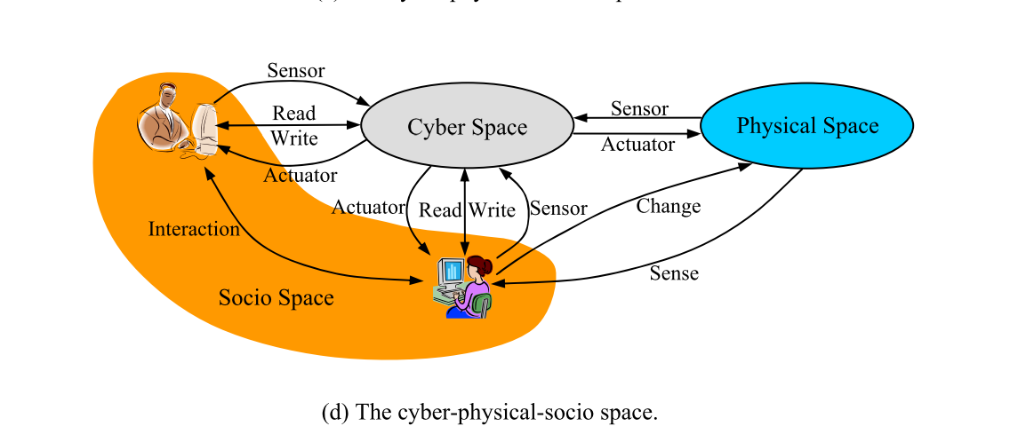

Slide 5
Coordination between Physical and Humans
Networks and organizational intelligence
Simultaneous decision making
Multimodal consultation
Self-adaptive construction and reconstruction of organizational structure

Slide 6
Objective - Better systems through integration of Multi-domains
Physical Domain
Information Domain
Cognitive Domain
Physical systems
Cyber Networks
Sensors
Mental Elements
Social Domain
Human Knowledge
Capabilities
Social Networks
Socio-cultural elements

Slide 7
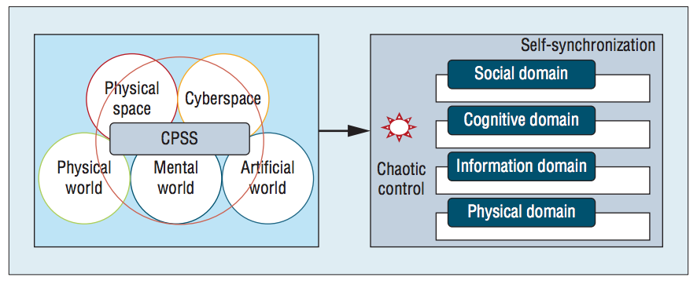

Slide 8
Self Synchronization
Vertical self-synchronization throughout the physical, information, cognitive, and social domains
Horizontal self-synchronization in each domain
Self-synchronization of structures and programs
Self-synchronization of the real world and virtual world for parallel execution

Slide 9
Humans and Machines
Humans consciously and subconsciously
  establish various links
  create semantic images
  Reason in mind to learn linking effect and rules
  Select linked entities to interact,
  Form closed loops through links while co-experiencing in multiple spaces in lifetime.
Machines are limited in these abilities
Cannot establish relationships unless explicitly mentioned

Slide 10
Computational Semantics
Language plays in establishing links among different entities
Cognitive grammar studies languages based on semantic, phonological, and symbolic units
Linguistic structures are motivated by general cognitive processes

Slide 11
Linking Cross-modal Entities
Semantic Net - directed graph, where nodes are concepts, and edges are the relations between concepts
Semantic Web – Web of data created by linking data residing at various locations on the Web
  Proposed to find, share, reuse and combine data

Slide 12
Semantic Web Technology
Machine-readable information
Builds on XML technology's capability to define customized tagging schemes and RDF's (Resource Description Framework) flexible approach to representing data
The Semantic Web provides common formats for the interchange of data
Common language for recording how data relates to real world objects across knowledge bases

Slide 13
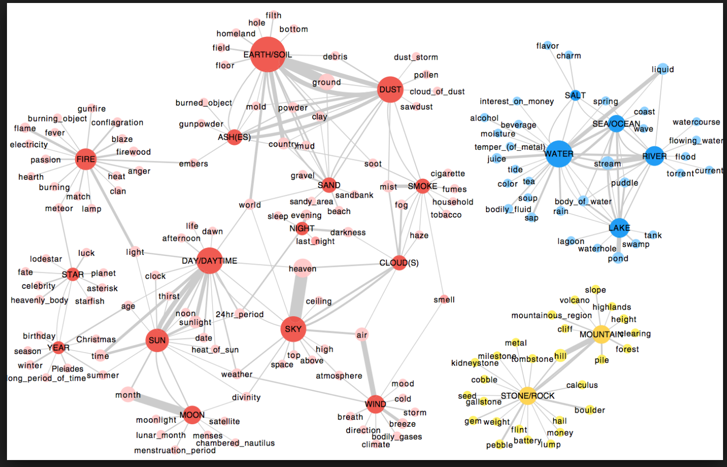
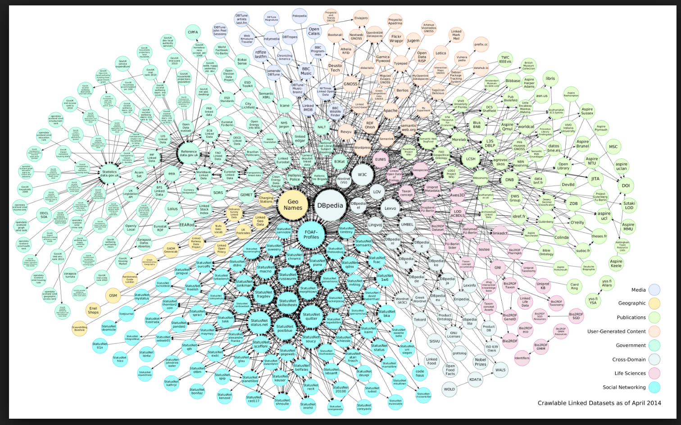
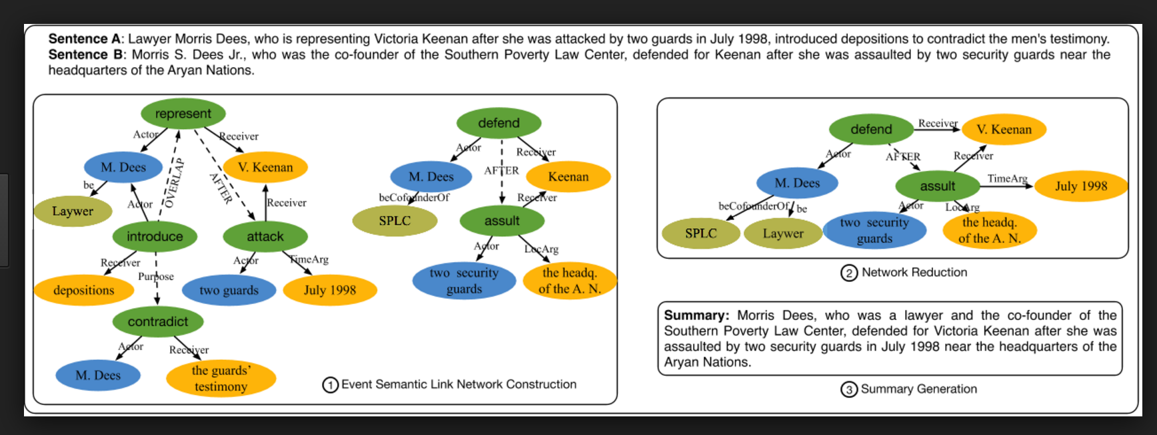
Semantic Linking - examples
Semantic Web
Linked Data

Slide 14
Limitations
Too simple to represent rich social relations or support causal reasoning over complex networks
Need
  Implication
  Type-subtype
  Cause-effect
  References

Slide 15
Semantic Linking for Cyber-physical-social systems
Semantic Indicators and rules to link objects across spaces
  Enable relational reasoning
  Analogical reasoning
  Inductive Reasoning
  Complex reasoning

Slide 16
Semantics
Adding Meaning to words
Ambiguities, Synonymy, Polysemy
Meaning is driven by context
Statistical, document analysis and natural language processing
  To obtain semantics from text or data

Slide 17
Semantics of Things
Classification semantic image –
  Classes, Sub-classes
  Classification Trees
Object semantic image
  attributes and class of object from multiple facets
  An instance of a point in a multi-dimensional classification space.
Individual semantic image
  is a semantic link network of objects or points in individual classification space – dynamically reflects the characteristics, behaviors and experiences of individuals.

Slide 18
Relation Semantics
Relation semantic image is the direct or indirect relation between two nodes (objects, individuals or classes)
  Rules of classification, reasoning, and interaction. Rules may be connected with each other for reasoning
  The inter-connected rules form a kind of rule closure that determines the implied semantic links.
Interaction semantic image is a semantic link network of objects or points in the classification space shared between individuals
  It forms and evolves through constant interaction

Slide 19
Interactive Semantics
Hard to create one model to suit all applications
Different semantic models should co-exist, support each other, and play different roles in computing and modeling
Establishing mappings between models
  Complementing or integrating existing models provides new capacity of semantic modeling
AI models have the ability to find the intrinsic rules in large-scale networks – that humans don’t have

Slide 20
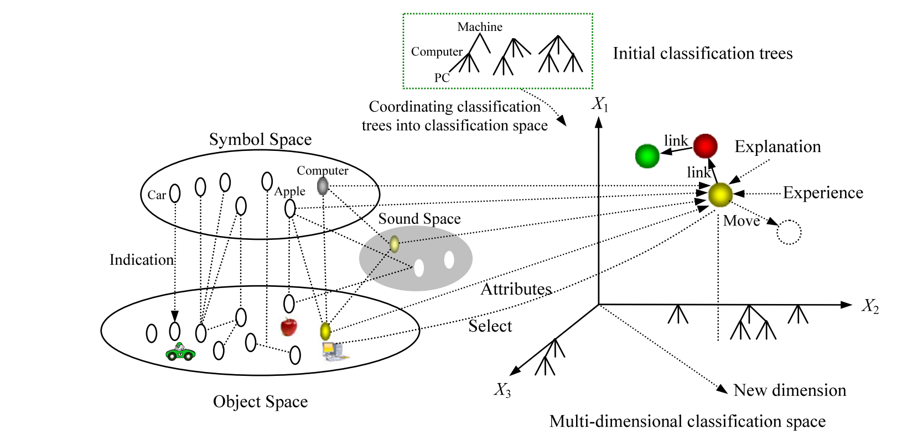
A point in a normalized space S has projection on every dimension,
denoted as p(X1 = c1p,..., Xn = cnp), where cip indicates a class at dimension Xi

Slide 21
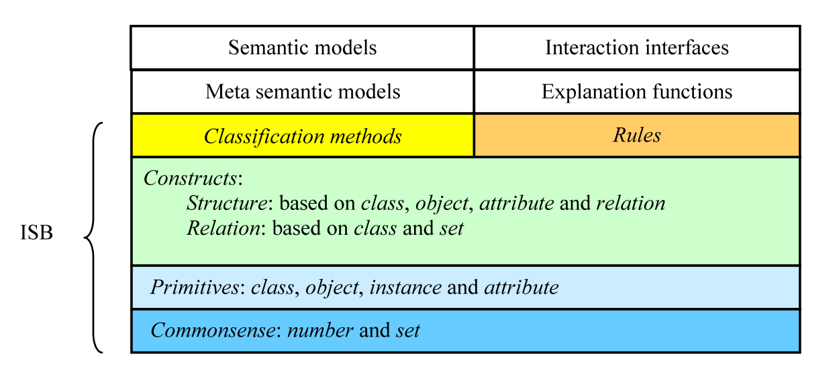
Interactive Semantics Base

Slide 22
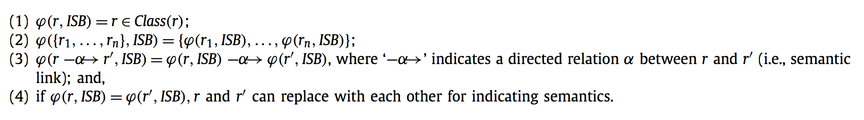
Semantic Function ψ
Resource Space Model + Database + OWL

Slide 23
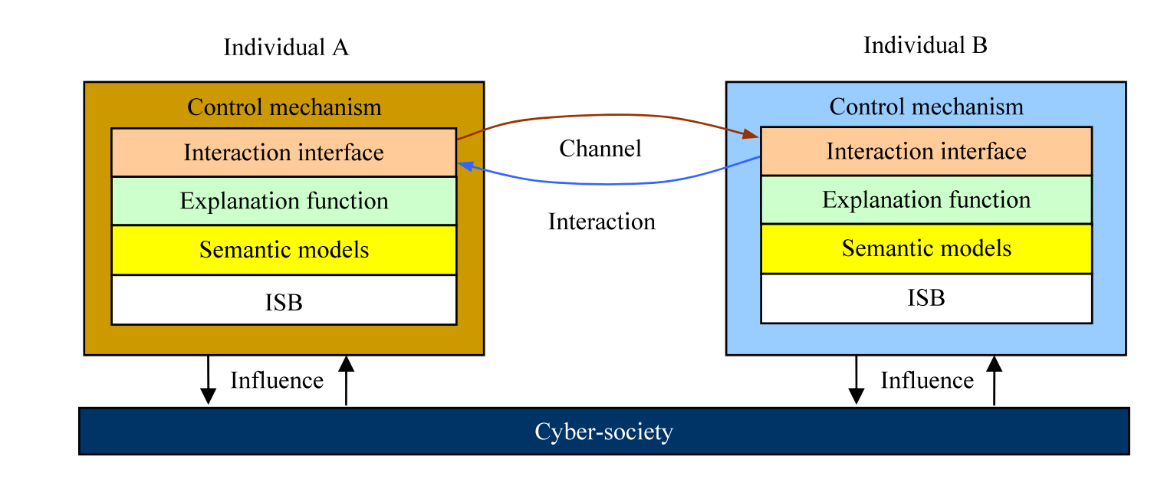
Architecture of Semantic Interaction

Slide 24
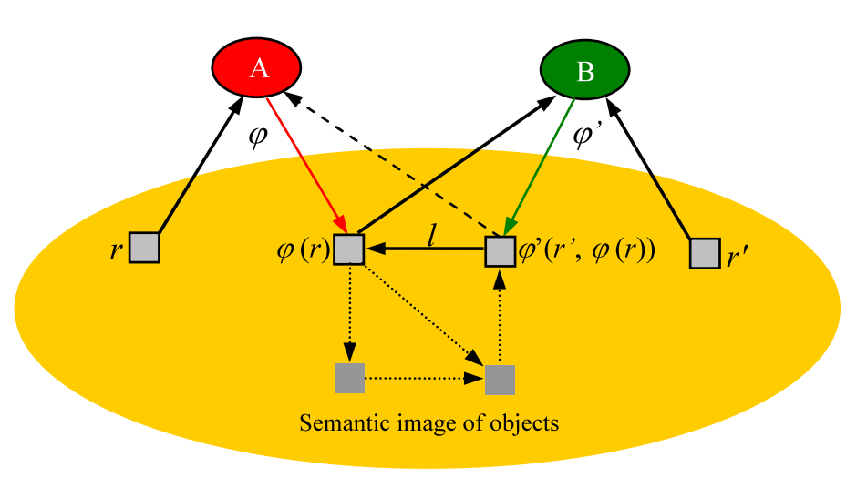
Establishing “indirect” interactions

Slide 25
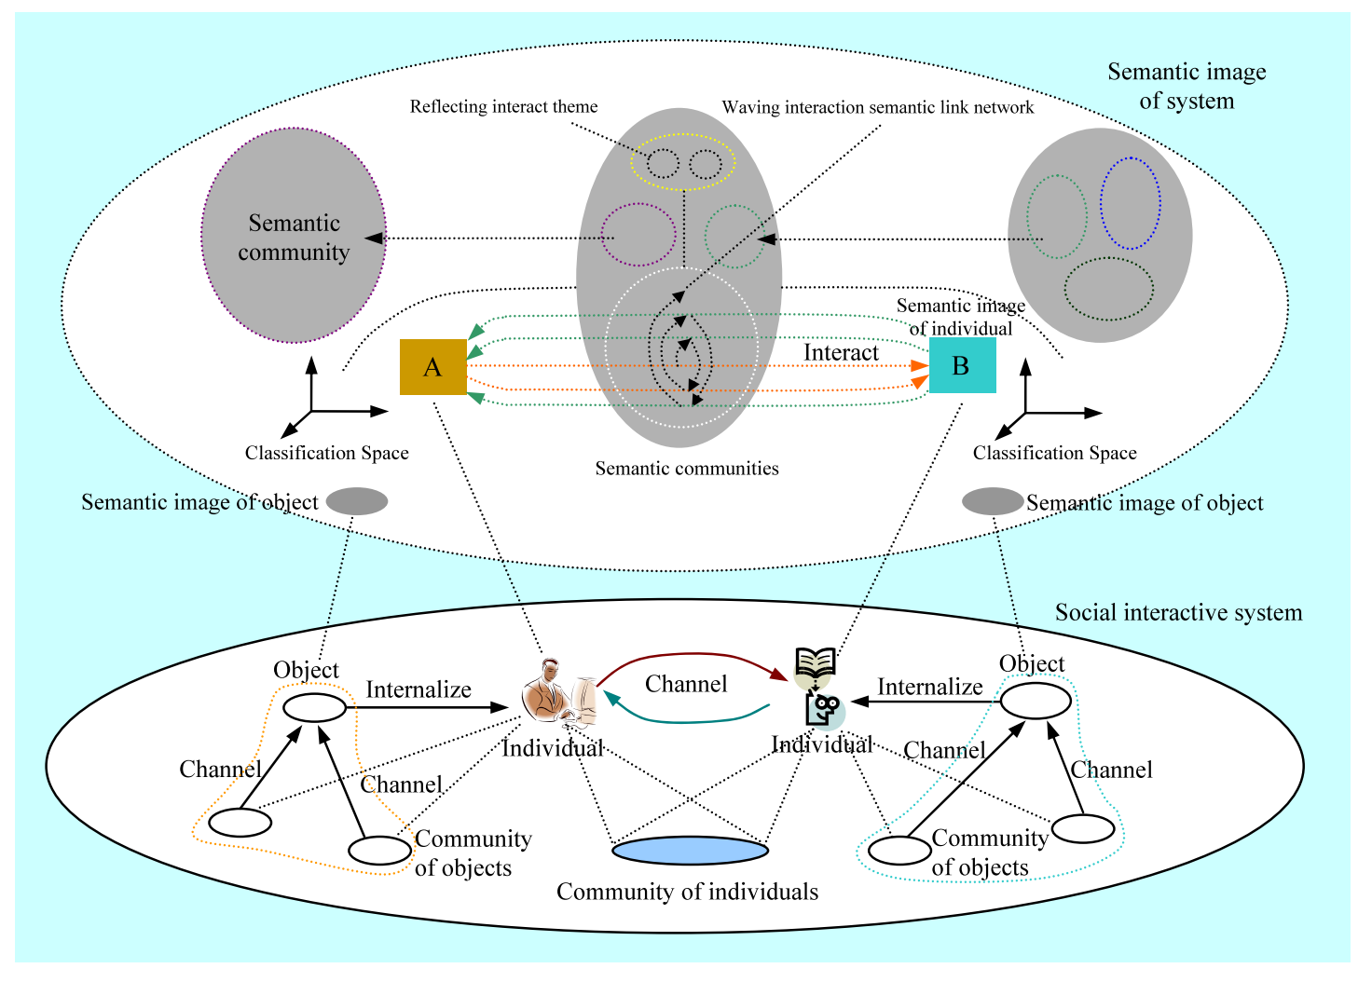
Semantic Image of an Interaction

Slide 26
Semantic Link Network
A semantic link network of points at time t : <P, L, Rules>
where P = {p1(t), w1(t),...,pn(t), wn(t)}, n will change with the evolution of classification space;
wk(t) ∈ [0, 1] is the weight of point pk(t) in classification space at time t,
  it is adapted in positive proportion to the times of being accessed;
L = {l(pi(τ ), p j(τ )) | τ ∈ [0, t] is the time of adding relation l between pi(τ ) and p j(τ ), i and j ∈ [1,n]} is a set of semantic links added to the network from time to time during the evolution of the network
Rules is a set of reasoning or influence rules on L

Slide 27
Characteristics of Interactions
Individuals interact with each other on the topic relevant to the interaction semantic image or individual semantic images.
Individuals A & B understand each other’s externalization with degree η
Status of the system is uncertain due to the uncertain and undecidable behavior of individuals
System is sensitive to the order of semantic links being added to a semantic image
Adding or removing one semantic link to a semantic image could influence the whole semantic image

Slide 28
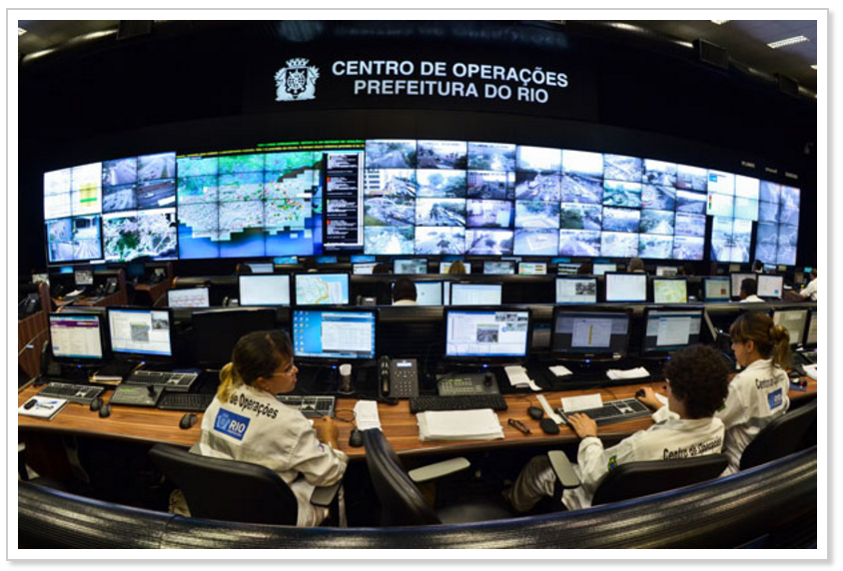


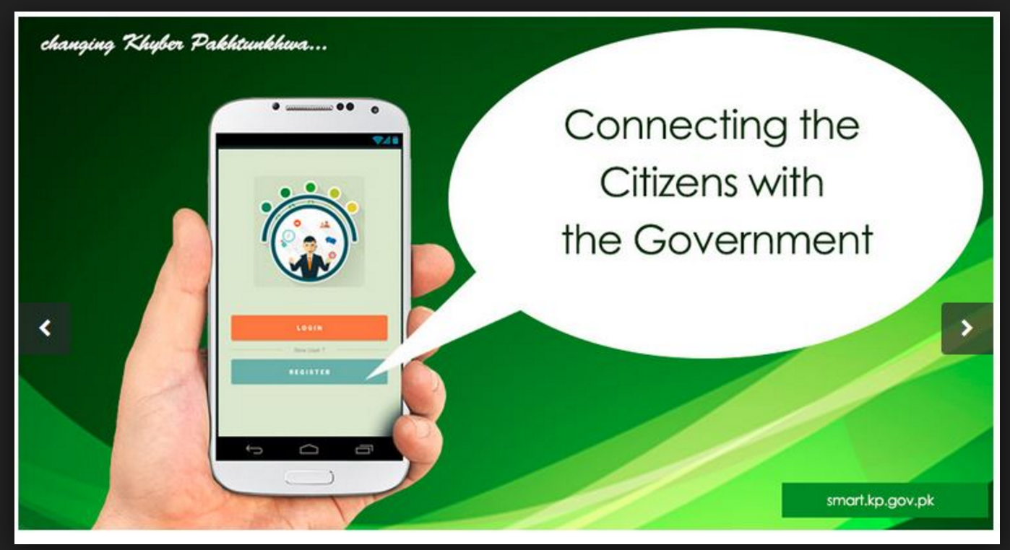
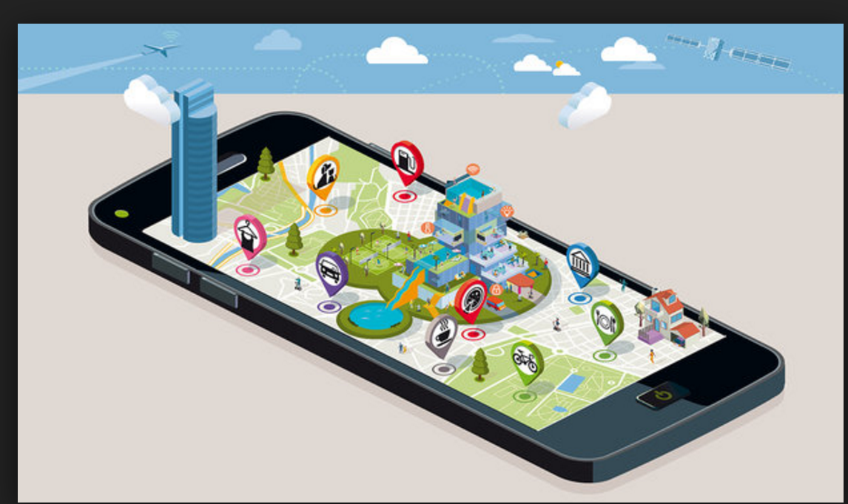
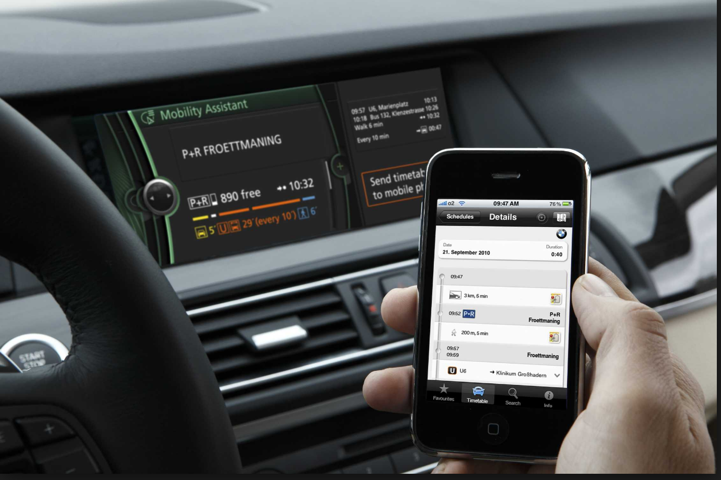
Social Sensing to Augment Smart Cities
Data of a city
  Road Intersections
  Power lines
  Buses
  Water Pipes
  Trash cans
  Air quality

Slide 29
Real Time Situation Awareness
Live Web applications - containing real-time information about all entities in the multi-dimensional classification space
  Time
  Location
  Event
  Audio
  Video
Information about others available to all resources
Resources in different spaces can self-organize

Slide 30
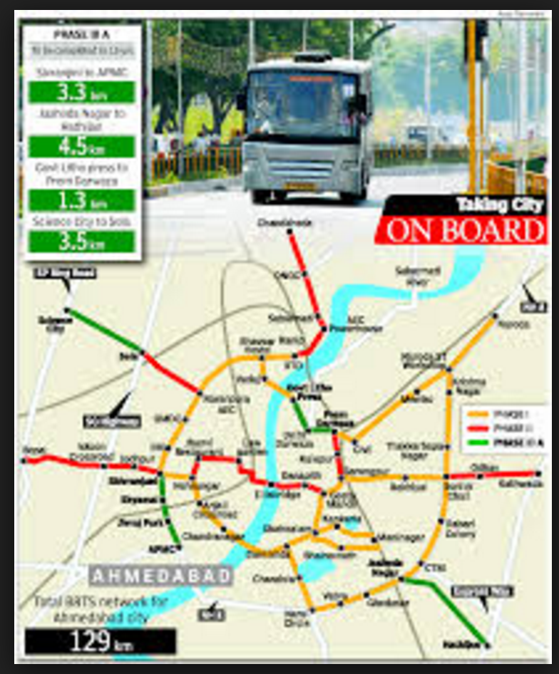
Starting simple
People use Google Maps for mobile with GPS enabled
Phone sends anonymous bits of data back to Google describing location and how fast one is moving
When all speeds of one location are combined
  Good estimate of traffic in location
Across thousands of phones moving around a city at any given time
  Good picture of live traffic conditions

Slide 31
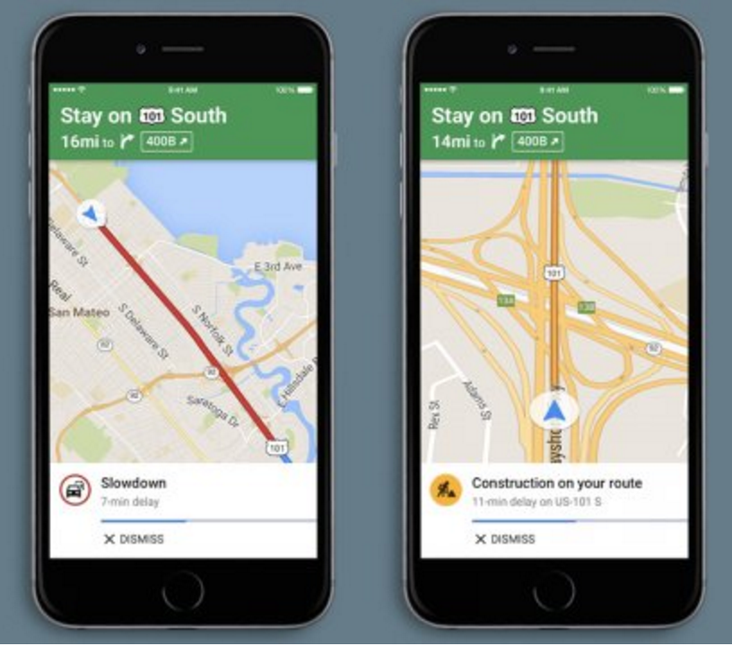
From knowing to guidance – Google Maps
Get “source” and “destination”
Compute alternate routes
Estimate time on each route based on “current state” and “knowledge”
Suggest best route
  Track
  Estimate
  Reroute
Repeat till “destination” reached

Slide 32
Prediction needs “Event Knowledge”
Why is a road congested?
  Construction work going on – Continue for days
  Waterlogging – Continue for hours
  Roadblock - Uncertain
  Procession – Short term / Uncertain

Slide 33
Knowledge incorporation in Prediction Models
Congestion
Route status does not change in real time
Waterlogging
Route warning
Roadblocks / Processions
Real Time updates
Estimated time based on current status
”not likely to clear”

Slide 34
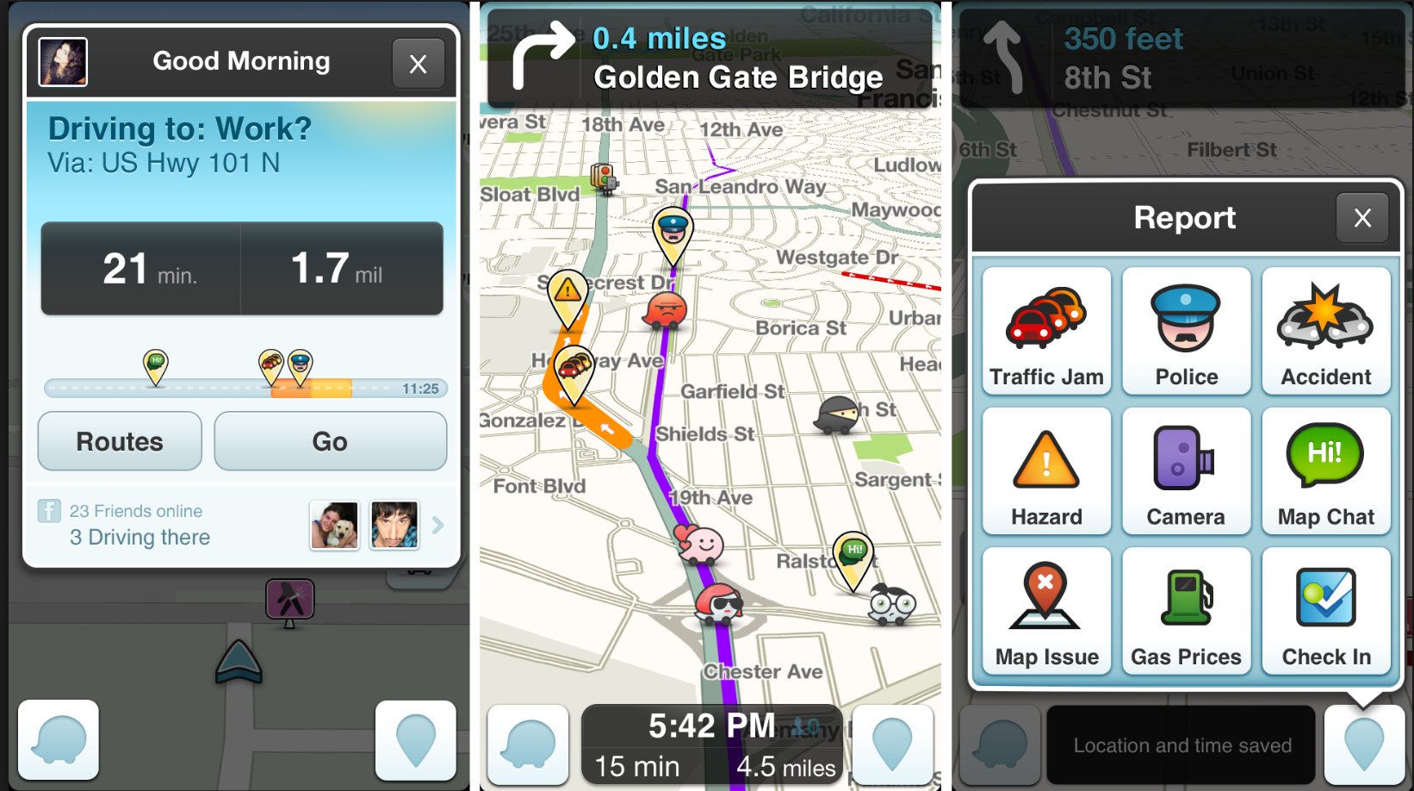
Crowd-sourcing Knowledge
Waze App – Restricted Semantics

Slide 35
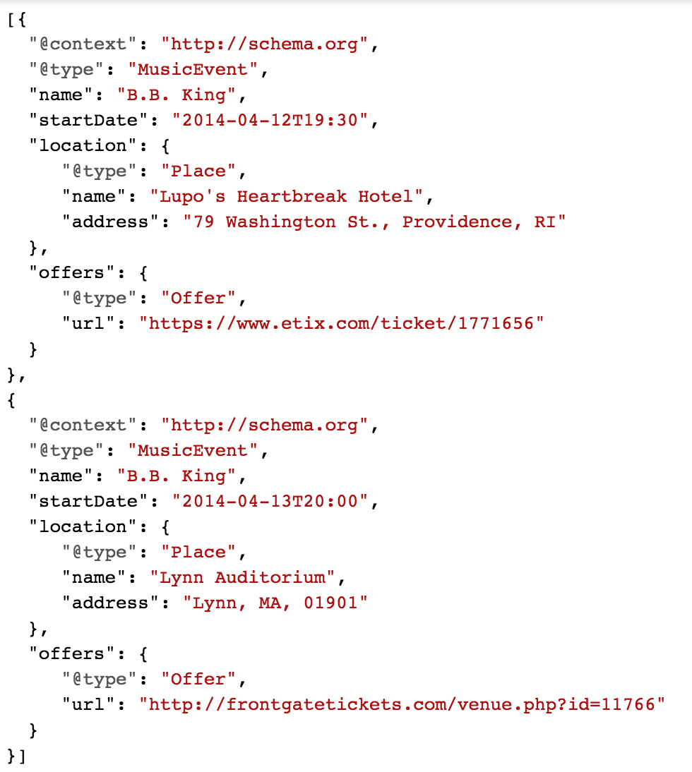
JSON-LD – linked data from Web
Linking Events, Places and Times

Slide 36

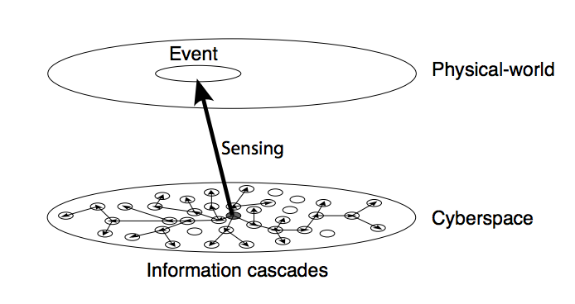
Social Sensors
Short Micro-blogging services – Text Updates
Geolocation Pictures
Video and picture
Real-Time

Slide 37
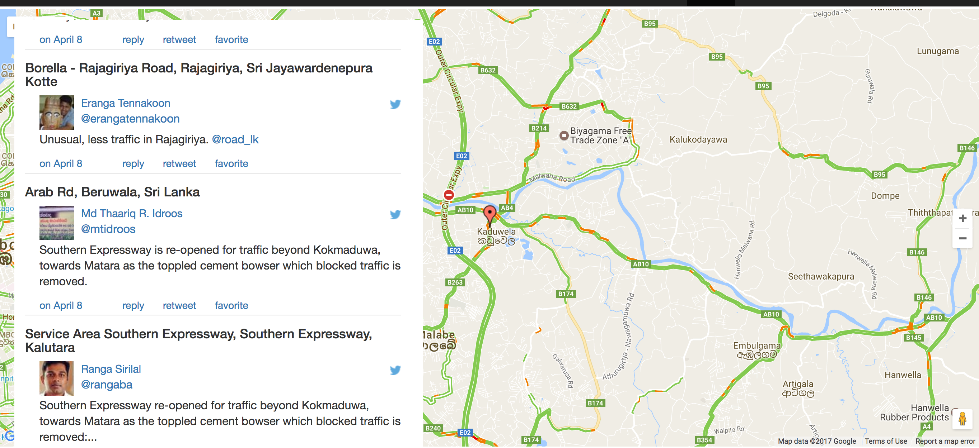
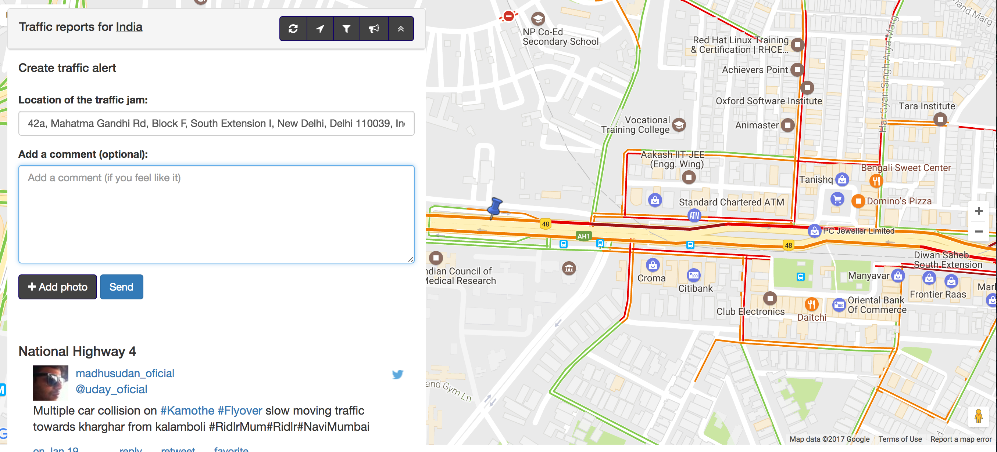
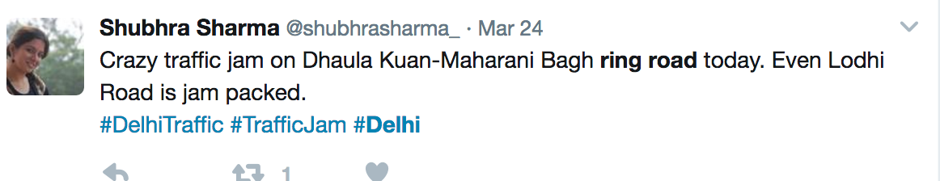
Crowd-sourcing – free flow of information

Slide 38
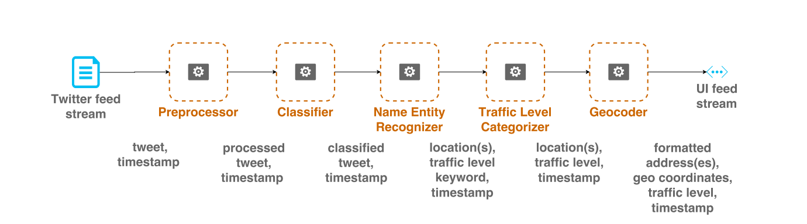
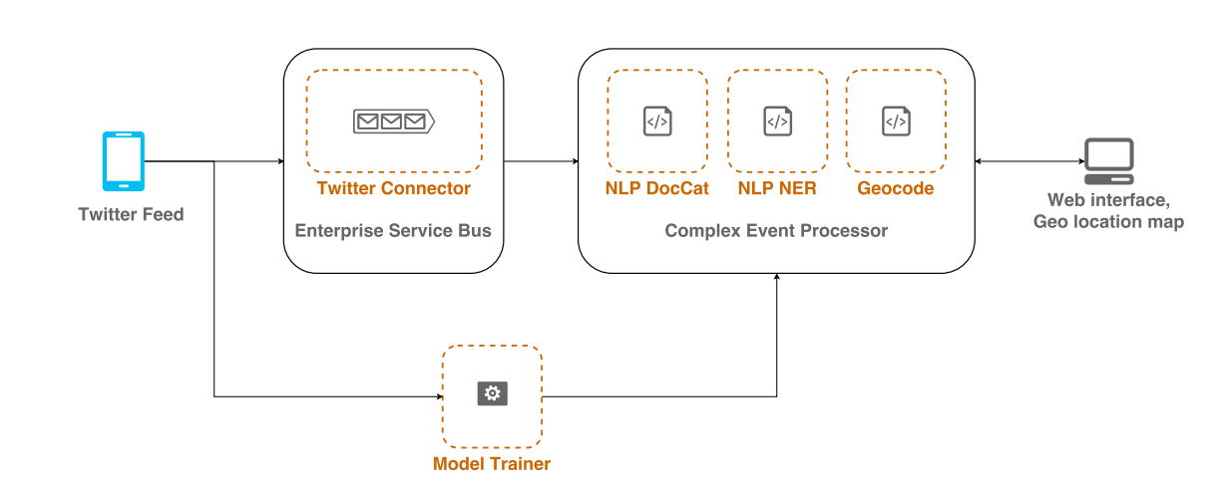
Making sense of content
Processing Pipeline
Natural Language Processing

Slide 39
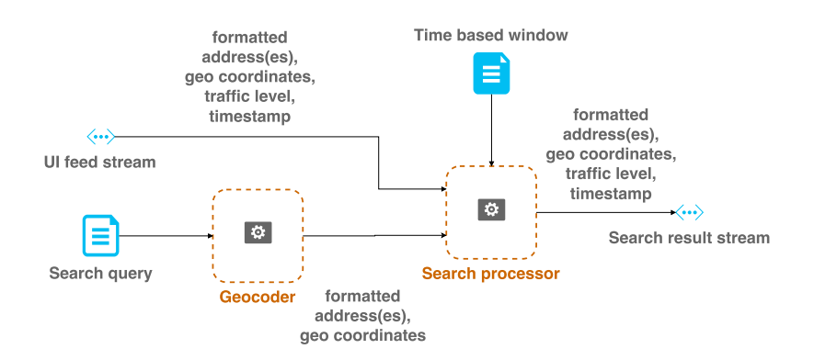
Pipeline for Geo-coded-information search

Slide 40
Social Sensing for Disasters
Twitter acts as great social sensor for disasters
Real-time mapping of events
”Earthquake!”
”Now it is shaking! #Earthquake”
✔
I am attending an Earthquake
Conference”
”Someone is shaking hands with my boss”.
✖

Slide 41
Event Detection and Classification
An event is an arbitrary classification of a space/time region
An event has
  participating agents
  Passive factors
  Products
  Location in space/time

Slide 42
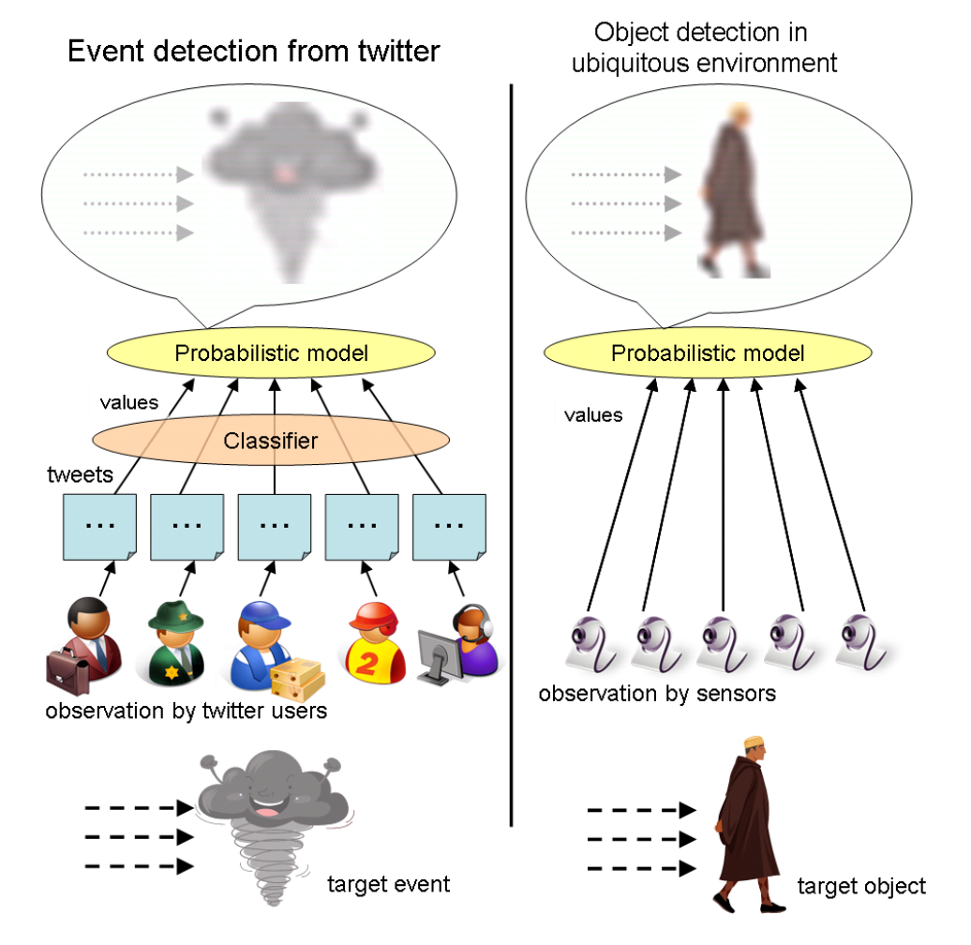
Probabilistic Classification

Slide 43
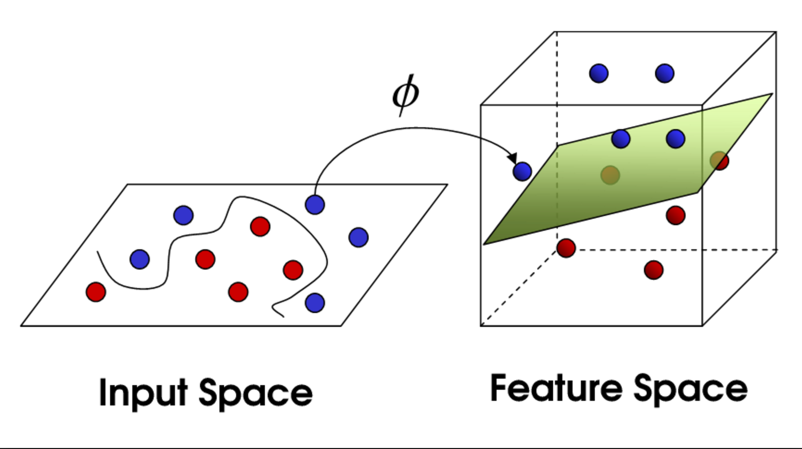
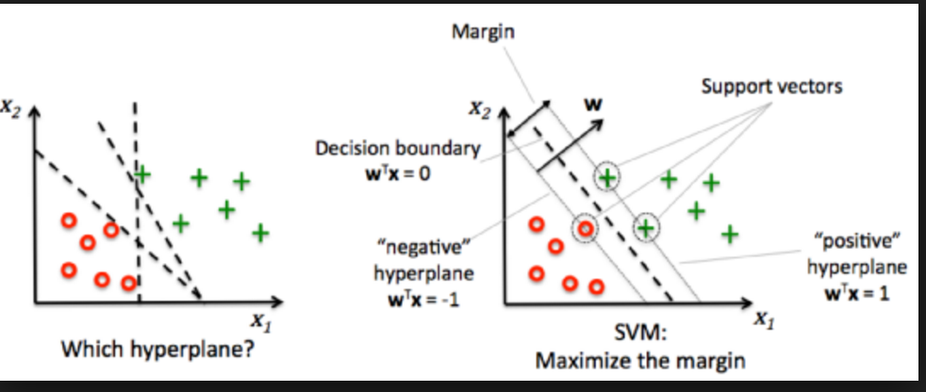
Classifying Tweets - SVM
Statistical features - number of words in a tweet message
Position of the query word
within a tweet
Keywords in a tweet
Word context features- the words before and after the query word

Slide 44

Time estimation from Positive Samples
Probability density function of an Earthquake event
Λ = 0.34
For tweets - infer that if a user detects an
event at time 0, the probability of tweeting about it from t to Δt is fixed as λ
Then, the time to make a tweet can be considered as an exponential distribution
Pf = 0.35 – probability of misclassification

Slide 45
Estimating time of event
Probability of event occurrence can be estimated as (1 − pf^{n})
Given n₀ sensors at time 0 and n₀e^{−λt} sensors at time t - . Therefore, the number of
sensors we expect at time t is n₀(1 − e−λ(t+1))/(1 − e−λ).
Consequently, the probability of an event occurrence at time t
p_{occur}(t)=1 − p_{f}^{n}₀^{(1−e−λ(t+1))/(1−e−λ)}
If n₀ tweets are received then an alarm with a false positive
ratio less than 1% can be made after time
t_{wait} = (1 − (0.1264/n₀))/0.7117 − 1.

Slide 46
Estimating Event-location from tweet location
Uses Kalman filtering - Linear quadratic estimation (LQE)
Uses a series of measurements observed over time, containing statistical noise and other inaccuracies
Produces estimates of unknown variables - tends to be more accurate than those based on a single measurement alone
Uses Bayesian inference and estimating a joint probability distribution over the variables for each timeframe.

Slide 47
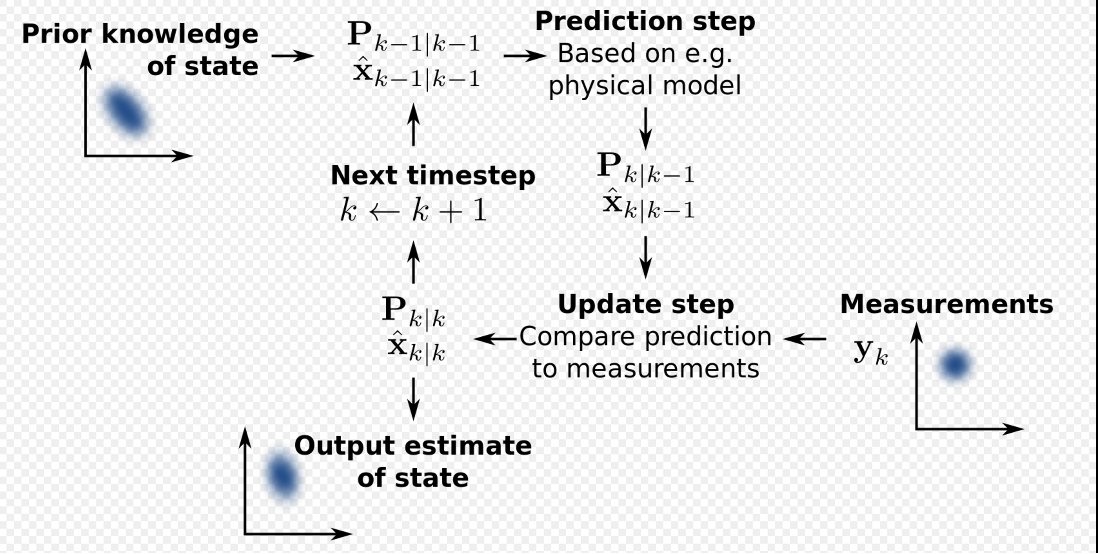
Estimating Event-location from tweet location
Estimates location from multiple observations
Updates Model
Actual Location

Slide 48
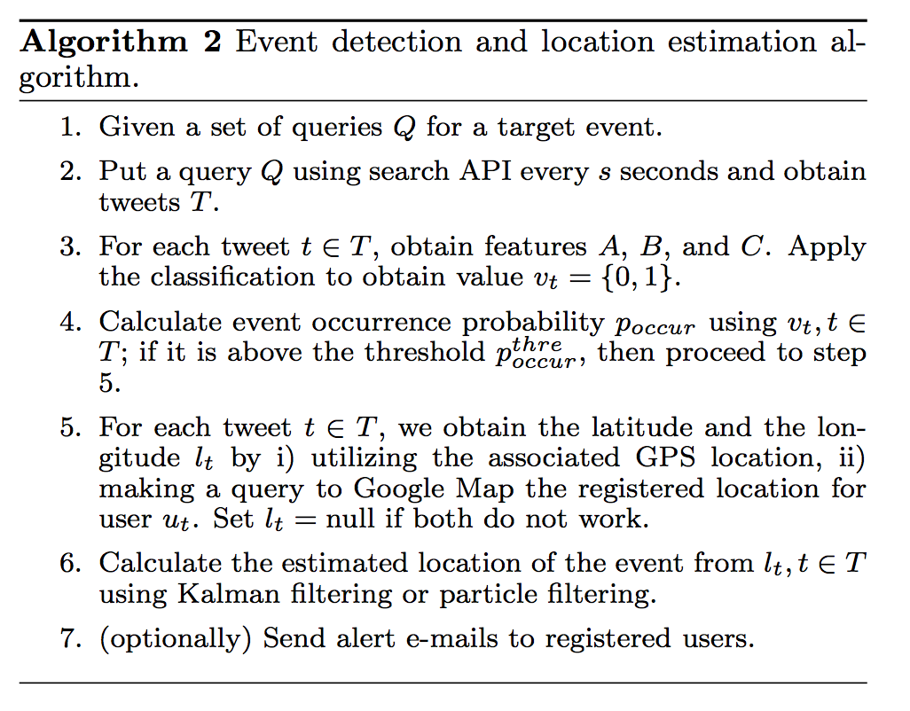
Algorithm

Slide 49
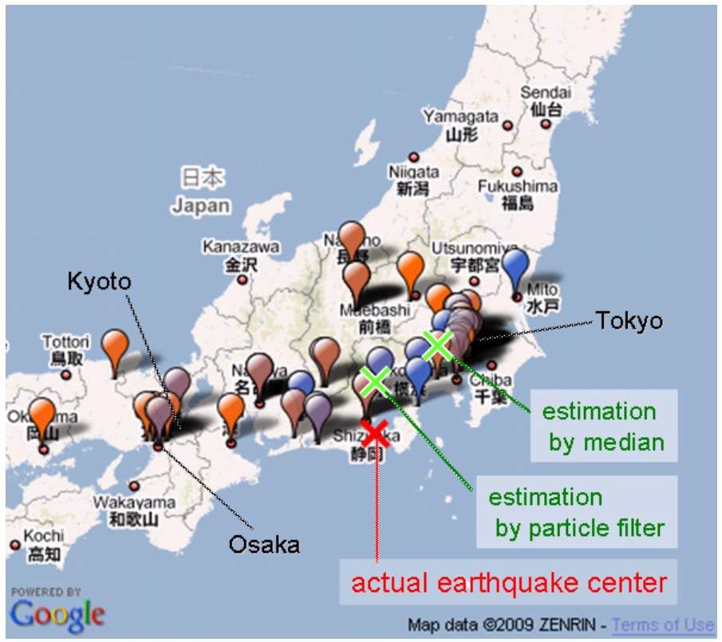
Experiment – earthquake location estimation based on tweets

Slide 50
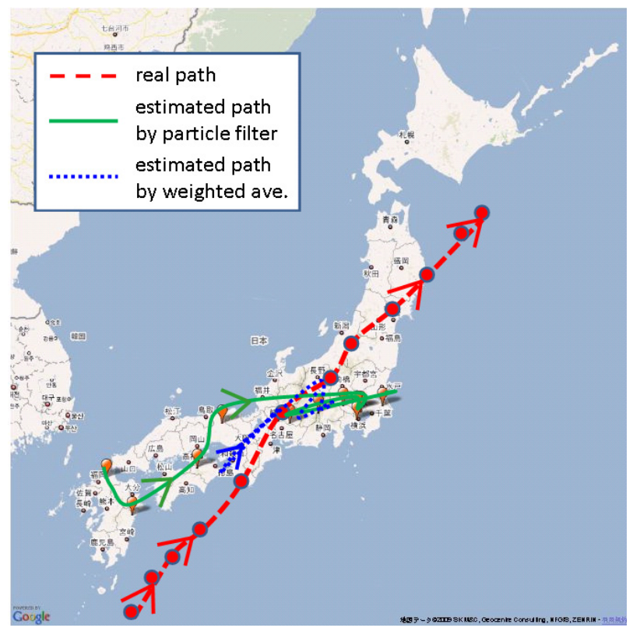
Typhoon trajectory detection

Slide 51
Earthquake prediction and Early warning system
Generates prediction-based alerts in 20s
Earthquake detection systems – 5 to 6 minutes
Sakaki, Takeshi, Makoto Okazaki, and Yutaka Matsuo.
"Earthquake shakes Twitter users: real-time event detection by social sensors." Proceedings of the 19th international conference on World wide web. ACM, 2010.

Slide 52
References
Hai Zhuge, “Interactive semantics”, Artificial Intelligence, 174, 2010, pp 170 -204
Hai Zhuge, Semantic linking through spaces for cyber-physical-socio intelligence: A methodology, Artificial Intelligence, 175, 988-1019
Liu, Zhong, et al. "Cyber-physical-social systems for command and control." IEEE Intelligent Systems 26.4 (2011): 92-96.
Athuraliya, C. D., et al. "Real-time natural language processing for crowdsourced road traffic alerts." Advances in ICT for Emerging Regions (ICTer), 2015

Slide 53
Thank you

Slide 54
Complex Links
Basis for interaction among entities
  Semantics of interaction
  Transmit material, energy, content, and control information to realize real-time interaction between individuals.

Slide 55
Multi-space coordination through Times
Through situations
  Health status
  Current micro-environment
  Socio attributes,
  Socio energy
  Semantic images of people

Slide 56
Linking Mental Agents
Nemes – mechanism to invoke representations of things
Polynemes invoke partial states of agents for representing some different aspects of a thing’s meaning, e.g., recognizing an apple arouses its properties and relevant experience
Micronemes provide a global context to the agents, or describe the subtle situations or concepts.

Slide 57
Nomes - control the operations on representations.
Isonomes inform agents of performing the same type of operations, for example, they can ask some agents to save their current state to short-term memory and load in a different state, or ask them to begin training a new long-term k-line to reproduce the current state, or ask them to imagine the consequences of taking a certain action.
Pronomes are isonomes for controlling the use of short-term memory representations, especially in a larger situation. Some pronomes connect to restricted types of short-term memories that can store only specific types of knowledge, while others are more general-purpose and influential and can reach most of the agents
Paranomes are sets of pronomes linked to each other so that assignments or changes made by one pronome to some representation produce corresponding operations to related representations. A paranome
was used to describe how knowledge represented in different ways could be related and treated together in a uniform manner. Using paranomes, one can coordinate the use of these multiple representations.

Slide 58
