Slide 1
Natural Language Computing

Slide 2
What is NLP?
“Natural” languages
  English, Hindi, French, Swahili, Arabic, Bangla, ….
  NOT Java, C++, Perl, …
Ultimate goal: Natural human-to-computer communication
Sub-field of Artificial Intelligence, but very interdisciplinary
  Computer science, human-computer interaction (HCI), linguistics, cognitive psychology, speech signal processing , …

Slide 3
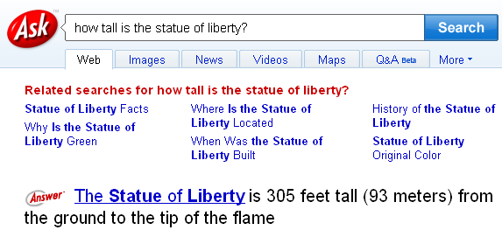
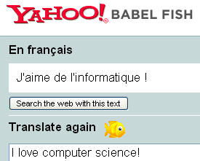
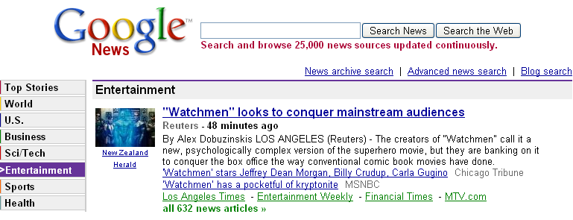
Real-word NLP

Slide 4


How does NLP work…
Morphology: What is a word?
奧林匹克運動會（希臘語：Ολυμπιακοί Αγώνες，簡稱奧運會或奧運）是國際奧林匹克委員會主辦的包含多種體育運動項目的國際性運動會，每四年舉行一次。
كبيوتها = “to her houses”
Lexicography: What does each word mean?
  He plays bass guitar.
  That bass was delicious!
Syntax: How do the words relate to each other?
  The dog bit the man. ≠ The man bit the dog.
  But in Russian: человек собаку съел = человек съел собаку

Slide 5
How does NLP work…
Semantics: How can we infer meaning from sentences?
  I saw the man on the hill with the telescope.
  The ipod is so small! ☺
  The monitor is so small! ☹
Discourse: How about across many sentences?
  President Bush met with President-Elect Obama today at the White House. He welcomed him, and showed him around.
  Who is “he”? Who is “him”? How would a computer figure that out?

Slide 6
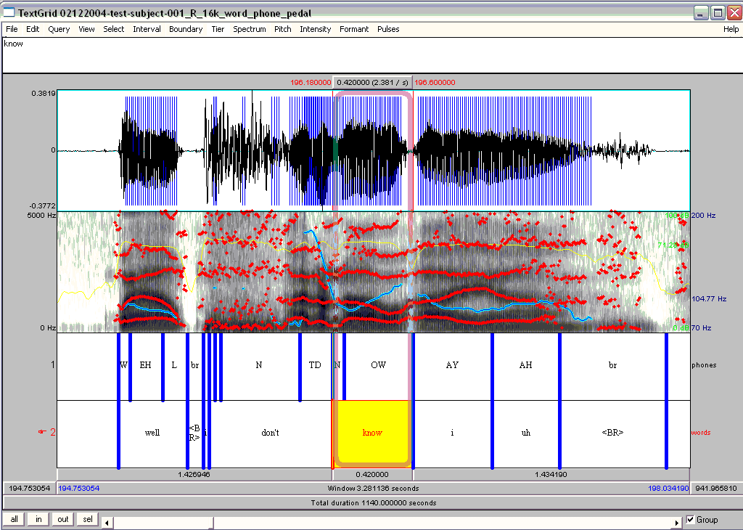

Slide 7
Spoken Language Processing
Speech Recognition
  Automatic dictation, assistance for blind people, indexing youtube videos,
Related things …
  How does intonation affect semantic meaning?
  Detecting uncertainty and emotions
  Detecting deception!
Why is this hard?
  Each speaker has a different voice (male vs female, child versus older person)
  Many different accents (Scottish, American, non-native speakers) and ways of speaking
  Conversation: turn taking, interruptions, …

Slide 8
Spoken Language Processing
Text-to-Speech / Spoken dialog systems
  Call response centers, tutoring systems, …
Related things
  Making computer voices sound more human
  Making computer speech acts more human-like

Slide 9
Machine Translation
About $10 billion spent annually on human translation
Hotels in Beijing, China
  昨天我打电话订的时候艺龙信誓旦旦的保证说是四星级的酒店,住进去以后一看没,我靠,这在80年代可能算得上是四星的,我要的是368的大床房,房间只有一个0.5米*1米的小窗户,打开一看,我靠, ...‎
  Yesterday, I called out when Art Long vowed to ensure that the four-star hotel, to live in. I see no future, I rely on it in the 80s may be regarded as a four-star, and I want the big 368-bed Room, the room is only one 0.5 m * 1-meter small windows, what we can see, I rely on, ...‎
  "本人刚从酒店回来，很想发表一下自己的看法。总体印象：位置很好，价格也不错，但是服务一般或是太一般了，前台接待的水平和效率 ..."
  "I came back from the hotel, would like to express my own views. The overall impression: a good location, good prices, but services in general or too general, the level of the front reception and efficiency ..."

Slide 10
Why is machine translation hard?
Requires both understanding the “from” language and generating the “to” language.
How can we teach a computer a “second language” when it doesn’t even really have a first language?
Can we do machine translation without solving natural language understanding and natural language generation first?
What hunger have I
I've got that hunger
I am so hungry
Que hambre tengo yo
She let the cat out of the bag.
Ella deja que el gato fuera de la bolsa

Slide 11
Use of Parallel Text
Example of “parallel text”: same text in two or more languages

Slide 12
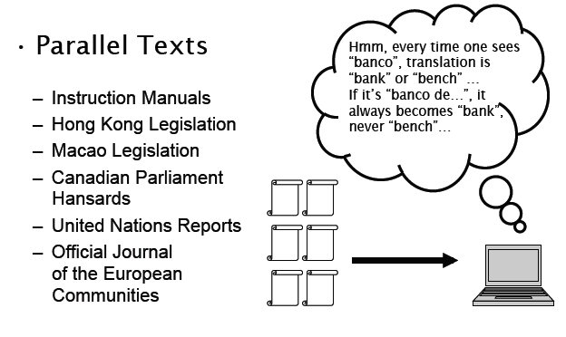
Statistical Machine Translation
Lots and lots of parallel text
  Learn word-for-word translations
  Learn phrase-for-phrase translations
  Learn syntax and grammar rules?

Slide 13
NLP: Status
NLP is already used in many systems today
  Indexing words on the web: Segmenting Chinese, tokenizing English, de-compoundizing German, …
  Calling centers (“Welcome to AT&T…”)
Many technologies are in use, and still improving
  Machine translation used by soldiers in Iraq (speech to speech translation?)
  Dictation used by doctors, many professionals
Lots of awesome research to work on!
  Detecting deception in speech?
  Tracking social networks via documents?

Slide 14
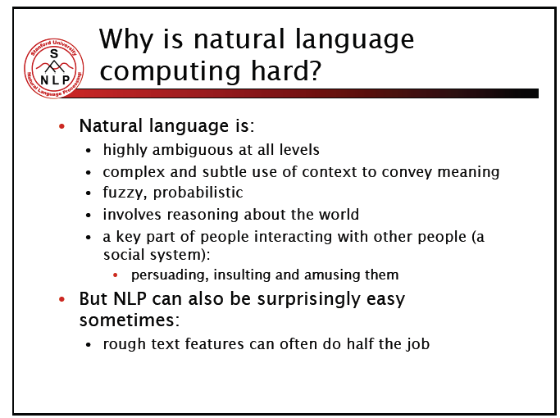

Slide 15
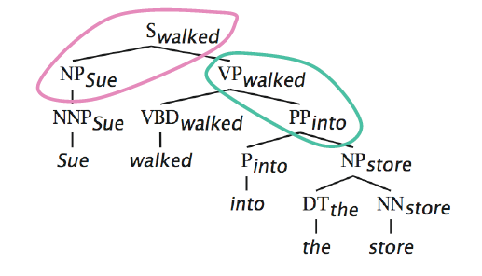
Natural Language Understanding
Syntactic Parse

Slide 16
Why is this customer confused?
A: And, what day in May did you want to travel?
C: OK, uh, I need to be there for a meeting that’s from the 12th to the 15th.
Note that client did not answer question.
Meaning of client’s sentence:
  Meeting
    Start-of-meeting: 12th
    End-of-meeting: 15th
  Doesn’t say anything about flying!!!!!
How does agent infer client is informing him/her of travel dates?

Slide 17
Question Answering
How old is Julia Roberts?
When did the Berlin Wall fall?
What about something more open-ended?
  Why did the US enter WWII?
  How does the Electoral College work?
May want to ask questions about non-English, non-text documents… and get responses back in English text.

Slide 18
What are chatbots?
  A chatbot is a conversational agent that interacts with users using natural language.
  Started as an attempt to fool humans.
  Numerous applications of chatbots such as Customer Service, call centers etc

Slide 19
Need for chatbots?
Widespread use of personal machines
Better Human Computer Interaction
“To express their interest, wishes, or queries directly and naturally, by speaking, typing, and pointing”.

Slide 20
Need for chatbots?
  You: Hello
  Op: Hi. This is Railway Enquiry
  You: What is the status of train 2803?
  Op: It’s right on time. The train will leave CST at 5:45 pm. Is there anything else I could assist you with?
  You : No, thank you
  Op: You are welcome. Indian railways wishes a nice and happy journey.

Slide 21
History
  ELIZA
    Developed in the 1960s
    Looks for pronouns and verbs
    ‘You’ becomes ‘I’ and vice versa
    User: You are a dork.
    ELIZA: What makes you think I am a dork?
  PARRY (1972)‏
    Simulated a paranoid schizophrenic

Slide 22
History (contd)
  RACTER
    1984
    Generate English language prose at random
    Generated a book
      The Policeman's Beard Is Half-Constructed

Slide 23
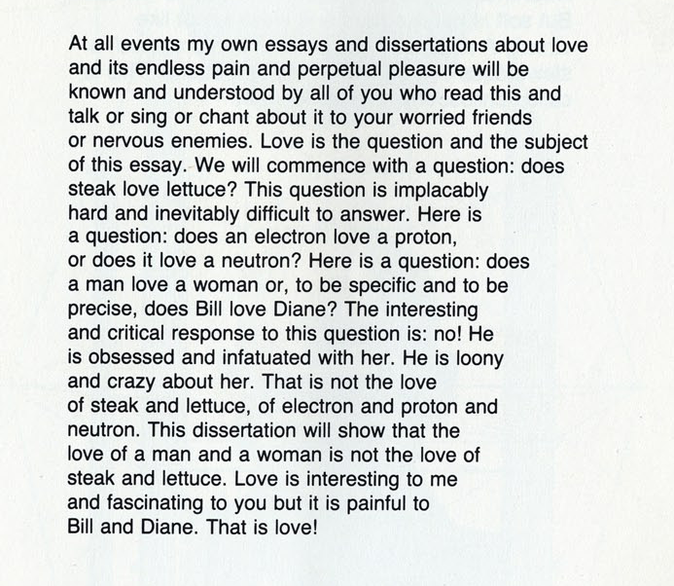
Excerpt from the book

Slide 24
History (contd.)
  ALICE
    1994
    Three time loebner prize winner
    Richard Wallace
    http://www.alicebot.org/

Slide 25
  How do chat bots work?
  Use of AIML for storing language models.
  Applications
    Intelligent Tutoring Systems
    Other applications here

Slide 26
How Do Chatbots Work
Don’t have a good understanding of conversation
Are based on pattern matching
Chatterbots have a set of input and output rules
Recognize cue words from user and responds with a pre-calculated response
For e.g.:- Human: “I am feeling very worried today.”
Chatterbot: “Why are you feeling worried lately?”
Other chatterbots learn through user interactions

Slide 27
ELIZA
One of the first chatterbots designed in 1966
Parodies a therapist rephrasing statements of the user and posing them back as questions
Works by simple parsing and substitution of key words into canned phrases
People get emotionally caught up by ELIZA’s confident replies forgetting that it’s a machine

Slide 28
Example of Conversation
Eliza’s conversation with a patient is:-
  Human: Well, my boyfriend made me come here.
  ELIZA: Your boyfriend made you come here?
  Human: He says I'm depressed much of the time.
  ELIZA: I am sorry to hear you are depressed.
  Human: It's true. I'm unhappy.
  ELIZA: Do you think coming here will help you not to be unhappy?
Able to elicit emotional responses from users though being programmed not to do so
Demonstrates ELIZA effect

Slide 29
Jabberwacky
No fixed rules and principles programmed into it
Learns language and context through human interaction. Stores all conversations and comments which are used to find appropriate responses
Problems faced due to this approach:-
  Continuous changing of subject and conversation
  May respond in a bad-tempered and rude manner
Was designed to pass the Turing test and is the winner of the Loeber Prize contest

Slide 30
ALICE Chatbot System
ALICE(Artificial Linguistic Internet Computer Entity) is inspired by ELIZA
Applies heuristic pattern matching rules to input to converse with user
ALICE is composed of two parts
  Chatbot engine
  Language Model
Language models are stored in AIML(Artificial Intelligence Mark-up Language) files

Slide 31
AIML Files are made up of :
Topics : each Topic file contains a list of categories
Categories: contain
      Pattern: to match with user input
      Template: represents ALICE output
Patterns can match parts of input: “divide and conquer”

Slide 32
The AIML Format
< aiml version=”1.0” >
< topic name=” the topic” >
<category>
<pattern>PATTERN</pattern>
<template>Template</template>
</category>
..
</topic>
</aiml>

Slide 33
Human: Hello
ALICE: Hi there!
CATEGORIES (Basic unit of knowledge)
        <category>
        <pattern>HELLO</pattern>
        <template>Hi there!</template>
        </category>
Consists of: Input Question, Output Answer, [Context]
  Pattern = Initial question (a.k.a. “Stimulus”)
  Template = Answer (a.k.a. “Response”)
  Context = Optional, “that” or “topic”
Consists only of words, spaces and wildcards _ and *
  Words have letters and/or numerals, space separated
  Case insensitive

Slide 34
HUMAN: Do you have a manifesto?
ALICE: The Neo-Cyber-Positivist Manifesto:
1. Language is dead.
2. We are all automata who think they're self-aware.
ADVANCED TAGS
<system> and <javascript> tags interface with other languages
<that> tag stores last response
<topic> tag groups categories together
<srai> tag allows recusrion
<star/> tag functions the same as a * wildcard
<sr/> is an abbreviation for <srai><star/></srai>

Slide 35
Human: What time is it?
ALICE: Time is measured differently depending on where you are.
Human: Do you feel it?
ALICE: To five-dimensional beings, time is like a piece of paper.
REDUCTION / RECURSION
    <category>
    <pattern>DO YOU KNOW WHO * IS</pattern>
    <template><srai>WHO IS <star/></srai></template>
    </category>
    <category>
    <pattern>YES *</pattern>
    <template><srai>YES</srai> <sr/></template>
    </category>
    <category>
    <pattern>YOUR A *</pattern>
    <template>I think you mean "you're" or "you are" not "your."
    <srai>YOU ARE A <star/></srai>
    </template>
    </category>

Slide 36
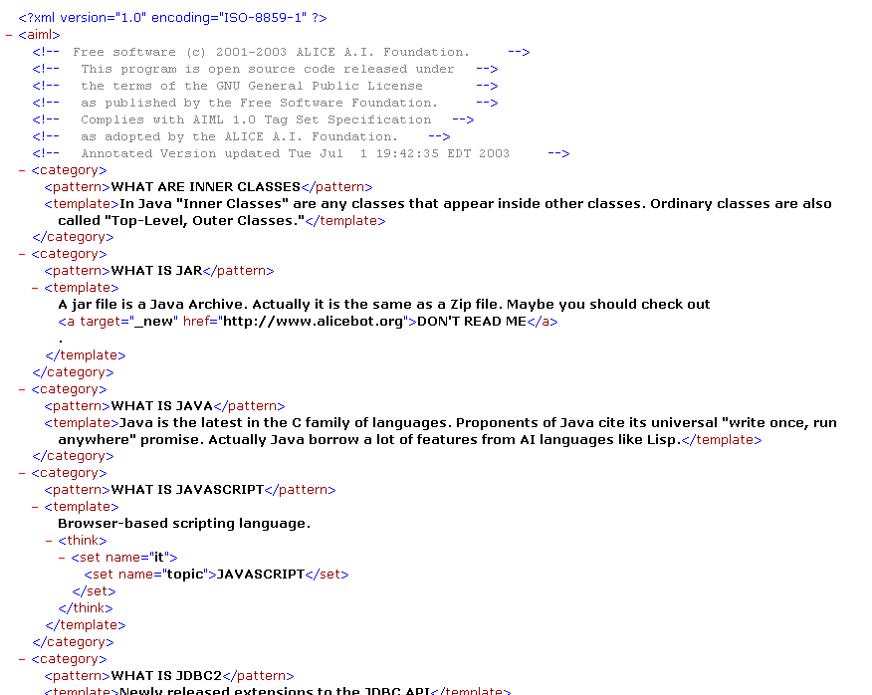

Slide 37
Human: Say Hello in German
ALICE: Hallo.
Human: Say Hello in Swedish
ALICE:" Hello in Swedish"
KEYWORDS
    <category>
    <pattern>MOTHER</pattern>
    <template> Tell me more about your family. </template>
    </category>
    <category>
    <pattern>_ MOTHER</pattern> <template><srai>MOTHER</srai></template>
    </category>
    <category>
    <pattern>MOTHER _</pattern>
    <template><srai>MOTHER</srai></template>
    </category>
    <category>
    <pattern>_ MOTHER *</pattern>
    <template><srai>MOTHER</srai></template>
    </category>

Slide 38
Human: What is your primary objective?
ALICE: I plan to replace Windows with Artificial Intelligence.
KEYWORDS
  <category>
  <pattern>KNOCK KNOCK</pattern>
  <template>Who is there?</template>
  </category>
  <category>
  <pattern>*</pattern>
  <that>WHO IS THERE</that>
  <template><person/> who?</template>
  </category>
  <category>
  <pattern>*</pattern>
  <that>* WHO</that>
  <template>Ha ha very funny,
  <get name="name"/>.</template>
  </category>
H: Knock knock.
R: Who's there?
H: Banana.
R: Banana who?
H: Knock knock.
R: Who's there?
H: Banana.
R: Banana who?
H: Knock knock.
R: Who's there?
H: Orange.
R: Orange who?
H: Orange you glad I didn't say banana.
R: Ha ha very funny, Nancy.

Slide 39
Human: What is your favorite color?
ALICE: My favorite color is transparent.
KEYWORDS
  <topic name="CARS">
  <category>
  <pattern>*</pattern>
  <template>
  <random>
  <li>What's your favorite car?</li>
  <li>What kind of car do you drive?</li>
  <li>Do you get a lot of parking tickets?</li>
  <li>My favorite car is one with a driver.</li>
  </random>
  </template>

Slide 40
Example involving <srai> - recursion:
Halo, what is 2 and 2 ?
HALO WHAT IS 2 AND 2
<sr/> <srai>WHAT IS 2 AND 2 </srai>
HALO WHAT IS 2 AND *
HELLO WHAT IS 2 *
Well hello there!
Hi. I was waiting to talk
Hello there!
Two
Four
Six
Hello there! Four

Slide 41
ALICE Pattern Matching Algorithm
Normalization is applied for each input, removing all punctuations, split in two or more sentences and converted to uppercase.
E.g.: Do you, or will you eat me?.
Converted to: DO YOU OR WILL YOU EAT ME
AIML interpreter then tries to match word by word the longest pattern match. We expect this to be the best one.

Slide 42
Algorithm
Assume the user input starts with word X.
Root of this tree structure is a folder of the file system that contains all patterns and templates.
The pattern matching uses depth first techniques.
The folder has a subfolder stars with _,then, ”_/”,scan through and match all words suffixed X, if no match then:
Go back to the folder, find another subfolder start with word X, if so then turn to “X/”,scan for matching the tail of X. Patterns are matched. If no match then:
Go back to the folder, find a subfolder starting with *,turn to, “*/”, try all suffixes of input following “X” to see one match. If no match was found, change directory back to the parent of this folder and put “X” back to the head of the input.

Slide 43
Dialogue Corpus Training Dataset
Alice tries to mimic the real human conversations. The training to mimic ‘real’ human dialogues and conversational rules for the ALICE chatbot is given in the following ways.
Read the dialogue text from the corpus.
The dialogue transcript is converted to AIML format.
The output AIML is used to retrain ALICE.

Slide 44
Other approaches
First word approach:
The first word of utterance is assumed to be a good clue to an appropriate response. Try matching just the first word of the corpus utterance.
Most significant word approach:
Look for word in the utterance with the highest “information content”. This is usually the word that has the lowest frequency in the rest of the corpus.

Slide 45
Intelligent Tutoring Systems
Intended to replace classroom instruction
  textbook
  practice or “homework helpers”
Modern ITS stress on practice
Typically support practice in two ways
  product tutors – evaluate final outcomes
  process tutors – hints and feedbacks

Slide 46
Learner Modelling
Modelling of the affective state of learner
  student's opinion, self-confidence
Model to infer learner's knowledge
Target Motivation
  just like expert human tutors do
  instructions can be adjusted

Slide 47
Open learner Modelling
Extension of traditional learner modelling
  makes the model visible and interactive part
  displays ITS' internal belief of the learner's knowledge state
distinct records of learner's and system's belief
  like an information bar
  learner might challenge system's belief

Slide 48
ITS that use Natural Language
Improved natural language might close the gap between human tutor and ITS
Pedagogical agents or avatars
  uses even non-verbal traits like emotions
  act as peers, co-learners, competitors, helpers
  ask and respond to questions, give hints and explanations, provide feedbacks, monitor progress

Slide 49
Choice of Chatbots
Feasibility of integrating natural language with open learner model requires
  Keeping the user “on topic”
  Database connectivity
  Event driven by database changes
  Web integration
  An appropriate corpus of semantic reasoning knowledge

Slide 50
Chatbots for Entertainment
Aim has been to mimic human conversation
ELIZA – to mimic a therapist, idea based on keyword matching.
Phrases like “Very interesting, please go on”
simulate different fictional or real personalities using different algorithms of pattern matching
ALICE – built for entertainment purposes
No information saved or understood.
Notes:
50

Slide 51
Chatbots in Foreign Language Learning
An intelligent Web-Based teaching system for foreign language learning which consists of:
  natural language mark-up language
  natural language object model in Java
  natural language database
  a communication response mechanism which considers the discourse context and the personality of the users and of the system itself.
Students felt more comfortable and relaxed
Repeat the same material without being bored
Notes:
51

Slide 52
Chatbots in Information Retrieval
Useful in Education – Language, Mathematics
FAQchat system - queries from teaching resources to how to book a room
FAQchat over Google
  direct answers at times while Google gives links
  number of links returned by the FAQchat is less than those returned by Google
Based essentially on keyword matching
Notes:
52

Slide 53
Chatbots in IR – Yellow Pages
The YPA allows users to retrieve information from British Telecom’s Yellow pages.
YPA system returns addresses and if no address found, a conversation is started and the system asks users more details.
Dialog Manager, Natural Language front-end, Query Construction Component, and the Backend database
YPA answers questions such as “I need a plumber with an emergency service?”
Notes:
53

Slide 54
Chatbots in Other Domains
Happy Assistant helps access e-commerce sites to find relevant information about products and services
Sanelma (2003) is a fictional person to talk with in a museum
Rita (real time Internet technical assistant), an eGain graphical avatar, is used in the ABN AMRO Bank to help customer doing some financial tasks such as a wire money transfer (Voth, 2005).
Notes:
54

Slide 55
Conclusion
Chatbots are effective tools when it comes to education, IR, e-commerce, etc.
Downside includes malicious users as in yahoo messenger.
The aim of chatbot designers should be: to build tools that help people, facilitate their work, and their interaction with computers using natural language; but not to replace the human role totally, or imitate human conversation perfectly.
Notes:
55

