Slide 1
Artificial Intelligence
CS F407
Vishal Gupta
Department of Computer Science and Information Systems
Birla Institute of Technology and Science
Pilani Campus, Pilani

Slide 2
Logical Agents
Few slides are taken from:

Slide 3
knowledge-based agents
Which work by processes of reasoning that operate on internal representations of knowledge.
Agents that have an explicit representation of knowledge that can be reasoned with.
These agents can manipulate this knowledge to infer new things at the “knowledge level”

Slide 4
knowledge-based agents
Knowledge base = set of sentences in a formal language
Declarative approach to building an agent (or other system):
  Tell it what it needs to know
Then it can Ask itself what to do - answers should follow from the KB
Agents can be viewed at the knowledge level - i.e., what they know, regardless of how implemented
Or at the implementation level
  i.e., data structures in KB and algorithms that manipulate them

Slide 5
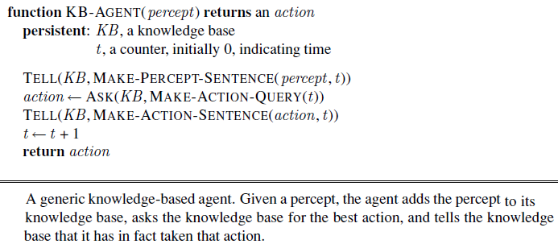
knowledge-based agents
MAKE-PERCEPT-SENTENCE constructs a sentence asserting that the agent perceived the given percept at the given time.
MAKE-ACTION-QUERY constructs a sentence that asks what action should be done at the current time.
MAKE-ACTION-SENTENCE constructs a sentence asserting that the chosen action was executed.

Slide 6
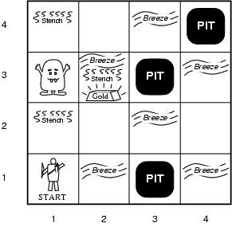
The Wumpus World

Slide 7
Wumpus World PEAS description
Performance measure
  gold +1000, death -1000
  -1 per step, -10 for using the arrow
Environment: 4 x 4 grid of rooms
  Squares adjacent to wumpus are smelly
  Squares adjacent to pit are breezy
  Glitter iff gold is in the same square
  Shooting kills wumpus if you are facing it
  Shooting uses up the only arrow
  Grabbing picks up gold if in same square
  Releasing drops the gold in same square
Sensors: Stench, Breeze, Glitter, Bump, Scream (shot Wumpus)
Actuators: Left turn, Right turn, Forward, Grab, Release, Shoot

Slide 8
Wumpus world characterization
Fully Observable
Deterministic
Episodic
Static
Discrete
Single-agent?
Notes:
Fully Observable – does sensors give access to full state of the environment?

Slide 9
Wumpus world characterization
Fully Observable No – only local perception
Deterministic
Episodic
Static
Discrete
Single-agent?
Notes:
Deterministic – is the next state completely determined by the current state and the action executed by the agent or is there some uncertaintity?

Slide 10
Wumpus world characterization
Fully Observable No – only local perception
Deterministic Yes – outcomes exactly specified
Episodic
Static
Discrete
Single-agent?
Notes:
Episodic (or sequential) – episodic means divided into independent atomic episodes (like an assembly line robot where decisions about the current part does not affect the decision on the next part) or Sequential – where current action affects future environments.

Slide 11
Wumpus world characterization
Fully Observable No – only local perception
Deterministic Yes – outcomes exactly specified
Episodic No – sequential at the level of actions
Static
Discrete
Single-agent?
Notes:
Static or dynamic? Does the world change as time goes by?

Slide 12
Wumpus world characterization
Fully Observable No – only local perception
Deterministic Yes – outcomes exactly specified
Episodic No – sequential at the level of actions
Static Yes – Wumpus and Pits do not move
Discrete
Single-agent?
Notes:
Discrete versus continuous

Slide 13
Wumpus world characterization
Fully Observable No – only local perception
Deterministic Yes – outcomes exactly specified
Episodic No – sequential at the level of actions
Static Yes – Wumpus and Pits do not move
Discrete Yes
Single-agent?
Notes:
Vs multi-agent?

Slide 14
Wumpus world characterization
Fully Observable No – only local perception
Deterministic Yes – outcomes exactly specified
Episodic No – sequential at the level of actions
Static Yes – Wumpus and Pits do not move
Discrete Yes
Single-agent? Yes – Wumpus is essentially a natural feature

Slide 15
Wumpus World
Percepts given to the agent
Stench
Breeze
Glitter
Bumb (ran into a wall)
Scream (wumpus has been hit by arrow)
Principle Difficulty: agent is initially ignorant of the configuration of the environment – going to have to reason to figure out where the gold is without getting killed!
Notes:
Agent always starts in square [1,1] facing right. Locations of the gold and the wumpus are chosen randomly (from squares other than the start square).
Note the agent perceives the environment - percept looks like
[stench, breeze, glitter, bump, scream]
Let’s see how the knowledge-based agent would explore the world – trying to learn whether or not it can locate the gold without getting killed.

Slide 16
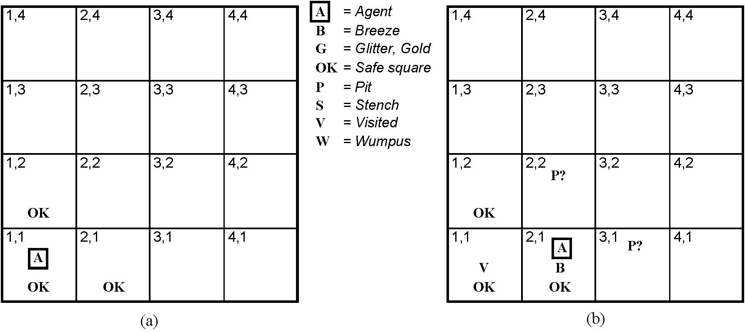
Exploring the Wumpus World
Initial situation:
Agent in 1,1 and percept is
[None, None, None, None, None]
From this the agent can infer the neighboring squares are safe (otherwise there would be a breeze or a stench)
Notes:
We will mark down what we know – initially the agent (A) is in 1,1, and we know that that square is OK.
It then gets the first percept – remember order is
[stench, breeze, glitter, bump, scream] – and first percept has these all null.
A cautious agent will move only into a square it knows to be OK.

Slide 17
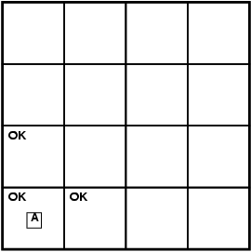
Exploring a wumpus world
Notes:
In initial state, there are no percepts (the sequence is none, none, none, none, none) and therefore it can be inferred that the neighboring squares are safe (OK).

Slide 18
Logic in general
Logics are formal languages for representing information such that conclusions can be drawn
Syntax defines how symbols can be put together to form the sentences in the language
Semantics define the "meaning" of sentences;
  i.e., define truth of a sentence in a world (given an interpretation)
E.g., the language of arithmetic
  x+2 ≥ y is a sentence; x2+y > {} is not a sentence
  x+2 ≥ y is true iff the number x+2 is no less than the number y
  x+2 ≥ y is true in a world where x = 7, y = 1
  x+2 ≥ y is false in a world where x = 0, y = 6

Slide 19
Entailment
Entailment means that one thing follows logically from another:
KB ╞ α
Knowledge base KB entails sentence α if and only if α is true in all worlds where KB is true
  E.g., the KB containing “the Phillies won” and “the Reds won” entails “Either the Phillies won or the Reds won”
  E.g., x+y = 4 entails 4 = x+y
  Entailment is a relationship between sentences (i.e., syntax) that is based on semantics

Slide 20
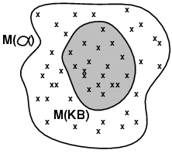
Models
Logicians typically think in terms of models, which are formally structured worlds with respect to which truth can be evaluated
We say m is a model of a sentence α if α is true in m
M(α) is the set of all models of α
Then KB ╞ α iff M(KB) ⊆ M(α)
  E.g. KB = Phillies won and
  Yankees won
  α = Phillies won

Slide 21
Entailment in the wumpus world
The agent has detected nothing in [1,1] and a breeze in [2,1]. These percepts, combined with the agent’s knowledge of the rules of the wumpus world, constitute the KB.
The agent is interested (among other things) in whether the adjacent squares [1,2], [2,2], and [3,1] contain pits.
Each of the three squares might or might not contain a pit, so (for the purposes of this example) there are 2³ =8 possible models.

Slide 22
Entailment in the wumpus world
Hence, KB ╞ α₁; But, KB does not╞ α₂

Slide 23

Inference and Entailment
Inference is a procedure that allows new sentences to be derived from a knowledge base.
Understanding inference and entailment: think of
  Set of all consequences of a KB as a haystack
  α as the needle
Entailment is like the needle being in the haystack Inference is like finding it

Slide 24
Inference Algorithm
KB ├_{i} α = sentence α can be derived from KB by inference algorithm i.
Soundness:An inference algorithm that derives only entailed sentences is called sound or truth preserving.
  i is sound if whenever KB ├_{i} α, it is also true that KB╞ α
Completeness: an inference algorithm is complete if it can derive any sentence that is entailed.
  i is complete if whenever KB╞ α, it is also true that KB ├_{i} α
Preview: we will define a logic (first-order logic) which is expressive enough to say almost anything of interest, and for which there exists a sound and complete inference procedure.
That is, the procedure will answer any question whose answer follows from what is known by the KB.

Slide 25
Propositional Logic: A Very Simple Logic
We need to understand:
The syntax of propositional logic
The semantics (i.e. the way in which the truth of sentences is determined).
Entailment: the relation between a sentence and another sentence that follows from it—and see how this leads to a simple algorithm for logical inference.

Slide 26
Propositional Logic: Syntax
The atomic sentences consist of a single proposition symbol.
Each such symbol stands for a proposition that can be true or false.
There are two proposition symbols with fixed meanings: True and False
Complex sentences are constructed from simpler sentences, using parentheses and logical connectives. There are five connectives in common use:
  If S is a sentence, ¬(S) is a sentence (negation)
  If S₁ and S₂ are sentences, (S₁ ∧ S₂) is a sentence (conjunction)
  If S₁ and S₂ are sentences, (S₁ ∨ S₂) is a sentence (disjunction)
  If S₁ and S₂ are sentences, (S₁ ⇒ S₂) is a sentence (implication)
  If S₁ and S₂ are sentences, (S₁ ⇔ S₂) is a sentence (biconditional)

Slide 27
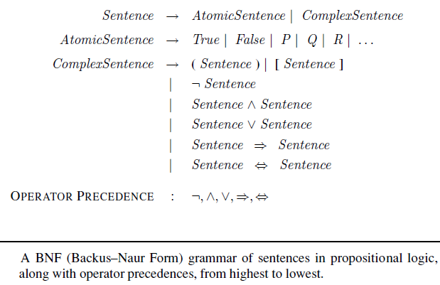
Propositional Logic: Syntax

Slide 28
Propositional logic: Semantics
Each model specifies true/false for each proposition symbol
  E.g. P_{1,2} P_{2,2} P_{3,1}
  false true false
With these symbols, 8 possible models, can be enumerated automatically.
Rules for evaluating truth with respect to a model m:
¬S is true iff S is false
S₁ ∧ S₂ is true iff S₁ is true and S₂ is true
S₁ ∨ S₂ is true iff S₁is true or S₂ is true
S₁ ⇒ S₂ is true iff S₁ is false or S₂ is true
i.e., is false iff S₁ is true and S₂ is false
S₁ ⇔ S₂ is true iff S₁⇒S₂ is true andS₂⇒S₁ is true
Simple recursive process evaluates an arbitrary sentence, e.g.,
¬P_{1,2} ∧ (P_{2,2} ∨ P_{3,1}) = true ∧ (true ∨ false) = true ∧ true = true

Slide 29
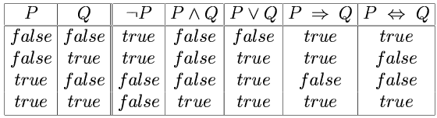
Truth tables for connectives

Slide 30
Knowledge base for the wumpus world
Let,
P_{x,y} is true if there is a pit in [x, y].
W_{x,y} is true if there is a wumpus in [x, y], dead or alive.
B_{x,y} is true if the agent perceives a breeze in [x, y].
S_{x,y} is true if the agent perceives a stench in [x, y].
  R1: ¬ P_{1,1}
  R2: B_{1,1} ⇔ (P_{1,2} ∨ P_{2,1})
  R3: B_{2,1} ⇔ (P_{1,1} ∨ P_{2,2} ∨ P_{3,1})
  R4: ¬B_{1,1}
  R5: B_{2,1}

Slide 31
Simple Inference Procedure
KB╞ α?
Model checking – enumerate the models, and check if α is true in every model in which KB is true. Size of truth table depends on # of atomic symbols.
Remember – a model is a mapping of all atomic symbols to true or false – use semantics of connectives to come to an interpretation for them.

Slide 32
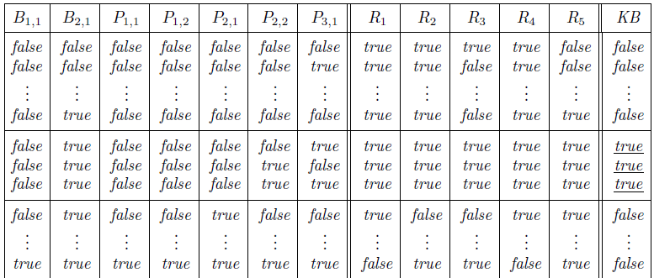
Truth tables for inference
A truth table constructed for the wumpus world knowledge base. KB is true
if R1 through R5 are true, which occurs in just 3 of the 128 rows (the ones underlined in the right-hand column).
Q. Is there a pit in P_{1, 2} ?
Q. Is there a pit in P_{2, 2}?

Slide 33
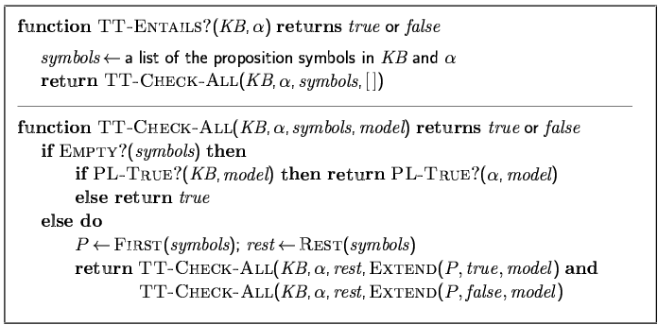
Inference by enumeration
Depth-first enumeration of all models is sound and complete
For n symbols, time complexity is O(2^{n}), space complexity is O(n)

Slide 34
Propositional Theorem Proving
We have seen entailment by model checking
How, entailment can be done by theorem proving ?
logical equivalence: two sentences α and β are logically equivalent if they are true in the same set of models. We write this as α ≡ β.
Also, any two sentences α and β are equivalent only if each of them entails the other:
α ≡ β if and only if α |= β and β |= α .

Slide 35
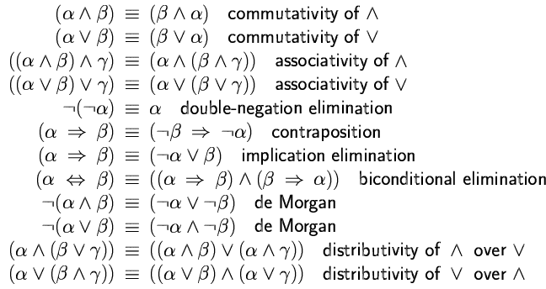
Propositional Theorem Proving

Slide 36
Validity and satisfiability
A sentence is valid if it is true in all models,
  e.g., True, A ∨¬A, A ⇒ A, (A ∧ (A ⇒ B)) ⇒ B
Validity is connected to inference via the Deduction Theorem:
  KB ╞ α if and only if (KB ⇒ α) is valid
A sentence is satisfiable if it is true in some model
  e.g., A∨ B, C
A sentence is unsatisfiable if it is true in no models
  e.g., A∧¬A
Satisfiability is connected to inference via the following:
  KB ╞ α if and only if (KB ∧¬α) is unsatisfiable

Slide 37
Inference and Proofs
Modus Ponens: AND Elimination:

Slide 38
Example
Given the following, infer ¬P_{1,2}
  R1: ¬ P_{1,1}
  R2: B_{1,1} ⇔ (P_{1,2} ∨ P_{2,1})
  R3: B_{2,1} ⇔ (P_{1,1} ∨ P_{2,2} ∨ P_{3,1})
  R4: ¬B_{1,1}
  R5: B_{2,1}

Slide 39
Example
Given the following, infer ¬P_{1,1}
  R1: ¬ P_{1,1}
  R2: B_{1,1} ⇔ (P_{1,2} ∨ P_{2,1})
  R3: B_{2,1} ⇔ (P_{1,1} ∨ P_{2,2} ∨ P_{3,1})
  R4: ¬B_{1,1}
  R5: B_{2,1}
Suppose the agent returns from [2,1] to [1,1] and then goes to [1,2], where it perceives a stench, but no breeze. We add the following facts to the knowledge base:
￢B_{1,2} .
B_{1,2} ⇔ (P_{1,1} ∨ P_{2,2} ∨ P_{1,3}) .

Slide 40
Q. How to use the search algorithms to find a sequence of steps that constitute a proof.

Slide 41
Proof by resolution
Resolution: a single inference rule, resolution, that yields a complete inference algorithm when coupled with any complete search algorithm.
What does the following two statements resolves to:
  R15 : P_{1,1} ∨ P_{2,2} ∨ P_{3,1}
  R13: ￢P_{2,2}
Unit resolution inference rule:
Where, each l is a literal and l_{i} and m are complementary literals.
Full resolution inference rule

Slide 42
Proof by resolution
Full resolution inference rule
where l_{i} and m_{j} are complementary literals.
Resolution rule forms the basis for a family of complete inference procedures.
A resolution-based theorem prover can, for any sentences α and β in propositional logic, decide whether α |= β.
Let See How …….

Slide 43
Conjunctive normal form
Conjunction (AND) and Disjunction (OR)
The resolution rule applies only to clauses (that is, disjunctions of literals),
A sentence expressed as a conjunction of clauses is said to be in conjunctive normal form (CNF).
Steps:
  Eliminate ⇔, replacing α ⇔ β with (α ⇒ β) ∧ (β ⇒ α).
  Eliminate ⇒, replacing α ⇒ β with ￢α ∨ β
  Move ￢ inwards by repeatedly applying double negation, and de-morgan laws.
  apply the distributivity law, distributing ∨ over ∧ wherever possible.

Slide 44
Conjunctive normal form
Steps:
  Eliminate ⇔, replacing α ⇔ β with (α ⇒ β) ∧ (β ⇒ α).
  Eliminate ⇒, replacing α ⇒ β with ￢α ∨ β
  Move ￢ inwards by repeatedly applying double negation, and de-morgan laws.
  apply the distributivity law, distributing ∨ over ∧ wherever possible.
    Convert the sentence B ⇔ (P ∨ Q) into CNF.

Slide 45
A resolution algorithm
Resolution Closure RC(S) of a set of clauses S is the set of all clauses derivable by repeated application of the resolution rule to clauses in S or their derivatives.
Ground resolution theorem: If a set of clauses is unsatisfiable, then the resolution closure of those clauses contains the empty clause.
Ground resolution theorem can be proved using its contrapositive.
To show that KB |= α, we have to show that (KB ∧ ￢α) is unsatisfiable.
Notes:
Therefore, if a formula ((KB ∧ ￢α) ) is in CNF, repeated application of resolution can search for an empty clause. IF it is found, then (KB ∧ ￢α) is unsatisfiable; Thus, KB |= α

Slide 46
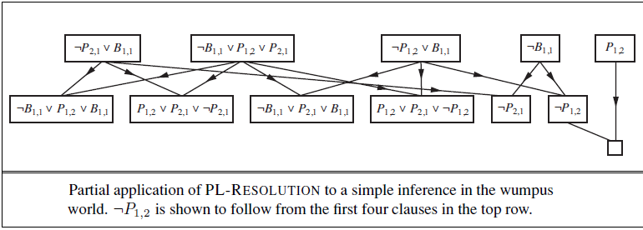
A resolution algorithm
To show that KB |= α, we show that (KB ∧ ￢α) is unsatisfiable.

Slide 47
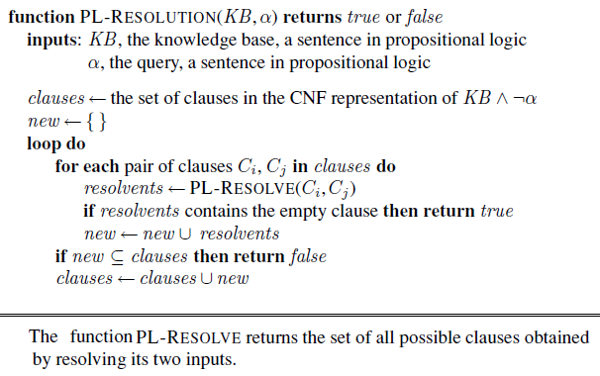
A resolution algorithm
To show that KB |= α, we show that (KB ∧ ￢α) is unsatisfiable.

Slide 48
Horn clauses and definite clauses
Can we improve upon the previous PL RESOLUTION algo for some specific cases?
Definite Clause: is a disjunction of literals of which exactly one is positive.
Horn Clause: is a disjunction of literals of which at most one is positive.
All definite clauses are Horn clauses
Clauses with no positive literals are called goal clauses.
Horn clauses are closed under resolution, i.e. if you resolve two Horn clauses, you get back a Horn clause.

Slide 49
Horn clauses and definite clauses
Every definite clause can be written as an implication whose premise is a conjunction of positive literals and whose conclusion is a single positive literal.
Inference with Horn clauses can be done through the forward-chaining and backward-chaining algorithms.
Deciding entailment with Horn clauses can be done in time that is linear in the size of the knowledge base

Slide 50
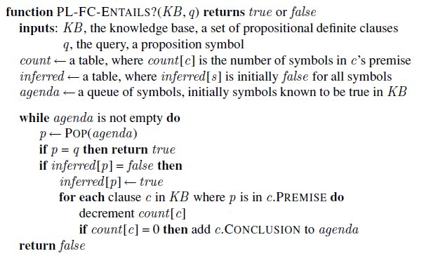
Forward Chaining Algorithm for Propositional Logic

Slide 51
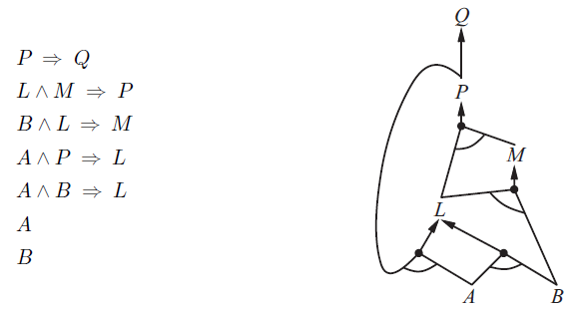

Slide 52
Effective propositional model checking
Depth-first enumeration of all models is sound and complete
For n symbols, time complexity is O(2^{n}), space complexity is O(n)

Slide 53
Davis Putnam algorithm
Early termination
Unit clause heuristic
Pure symbol heuristic
  if a sentence has a model, then it has a model with the pure symbols assigned so as to make their literals true, because doing so can never make a clause false.

Slide 54
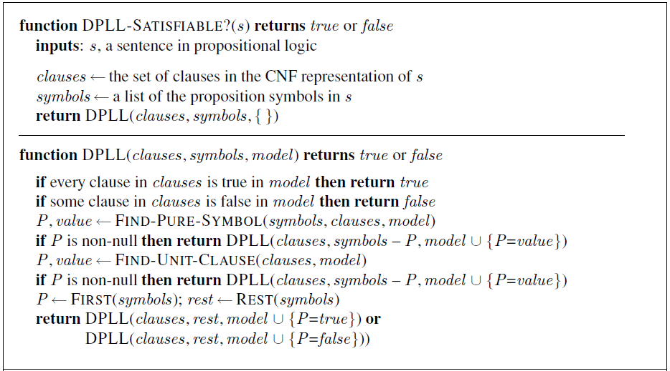
Davis Putnam algorithm

Slide 55
How to fasten SAT-Solvers
Component analysis
Variable and value ordering
Intelligent backtracking
Random restarts
Clever indexing

Slide 56
Agents Based On Propositional Logic
Three requirements:
Enable the agent to deduce, to the extent possible, the state of the world given its percept history.
How the agent can keep track of the world efficiently without going back into the percept history for each inference.
How the agent can use logical inference to construct plans that are guaranteed to achieve its goals.

Slide 57
Agents Based On Propositional Logic
The current state of the world:
The knowledge base is composed of:
  axioms: general knowledge about how the world works
  percept sentences: obtained from the agent’s experience
Problem: Deducing the current state of the wumpus world.

Slide 58
Agents Based On Propositional Logic
Collect axioms from general knowledge about how the world works:
Starting square contains no pit and no wumpus
  ￢P_{1,1} and ￢W_{1,1}
Square is breezy iff a neighboring square has a pit; and smelly iff a neighboring square has a wumpus.
  B_{1,1} ⇔ (P_{1,2} ∨ P_{2,1})
  S_{1,1} ⇔ (W_{1,2} ∨ W_{2,1})
  ・ ・ ・
There is exactly one wumpus (i.e. atleast one and atmost one)
  W_{1,1} ∨ W_{1,2} ∨ ・ ・ ・ ∨ W_{4,3} ∨ W_{4,4}
  ￢W_{1,1} ∨ ￢W_{1,2}
  ￢W_{1,1} ∨ ￢W_{1,3}
  ・ ・ ・
  ￢W_{4,3} ∨ ￢W_{4,4}

Slide 59
Agents Based On Propositional Logic
Consider agents percepts now:
a percept asserts something only about the current time; e.g. Stench⁴
fluent: an aspect of the world that changes.
The initial knowledge base includes
L⁰_{1,1} , FacingEast⁰, HaveArrow⁰, and WumpusAlive⁰
Connect stench and breeze percepts directly to the properties of the squares where they are experienced through the location fluent as follows.

Slide 60
Agents Based On Propositional Logic
Axioms that allow the agent to keep track of fluents such as L^{t}_{x,y}.
1. proposition symbols for the occurrences of actions.
  these symbols are indexed by time;
  Forward⁰ means that the agent executes the Forward action at time 0.
  By convention, the order is percept for a given time step, action for that time step, followed by a transition to the next time step.
  2. Effect axioms
Specify the outcome of an action at the next time step.
We would need one such sentence for each possible time step, for each of the 16 squares, and each of the four orientations.
We would also need similar sentences for the other actions: Grab, Shoot, Climb, TurnLeft, and TurnRight.
Frame problem
Notes:
effect axioms are required to describe how the world chamges.
For example, if the agent is at location [1, 1] facing
east at time 0 and goes Forward , the result is that the agent is in square [2, 1] and no longer
is in [1, 1]

Slide 61
Agents Based On Propositional Logic
Frame Axioms
Explicitly asserting all the propositions that remain the same.
For example, for each time t we would have
Forward^{t} ⇒ (HaveArrow^{t} ⇔ HaveArrow^{t+1})
Forward^{t} ⇒ (WumpusAlive^{t} ⇔ WumpusAlive^{t+1})
・ ・ ・
In a world with m different actions and n fluents, what is the size of the set of frame axioms ?
Representational frame problem.
Locality.
Notes:
In a world with m different actions and n
fluents, the set of frame axioms will be of size O(mn). This specific manifestation of the
frame problem is sometimes called the representational frame problem.

Slide 62
Agents Based On Propositional Logic
Solution to the Frame Problem
Change focus from writing axioms about actions to writing axioms about fluents.
For each fluent F, there is an axiom that defines the truth value of F^{t+1} in terms of fluents at time t and the actions that may have occurred at time t.
The truth value of F^{t+1} can be set in one of two ways:
  Action at time t causes F to be true at t+1
  F was already true at time t and the action at time t does not cause it to be false.
An axiom of this form is called a successor-state axiom and has this schema:
F^{t+1} ⇔ ActionCausesF^{t} ∨ (F^{t} ∧ ￢ActionCausesNotF^{t})

Slide 63
Agents Based On Propositional Logic
Example: Successor State Axiom
HaveArrow^{t+1} ⇔ (HaveArrow^{t} ∧ ￢Shoot^{t})
L^{t+1}_{1,1} ⇔ (L^{t}_{1,1} ∧ (￢Forward^{t} ∨ Bump^{t+1}))
∨ (L^{t}_{1,2} ∧ (South^{t} ∧ Forward^{t}))
∨ (L^{t}_{2,1} ∧ (West^{t} ∧ Forward^{t}))
Also, add the following to find whether a square is safe to move or not.
OK^{t}_{x,y} ⇔ ￢P_{x,y} ∧￢(W_{x,y} ∧ WumpusAlive^{t}) .

Slide 64
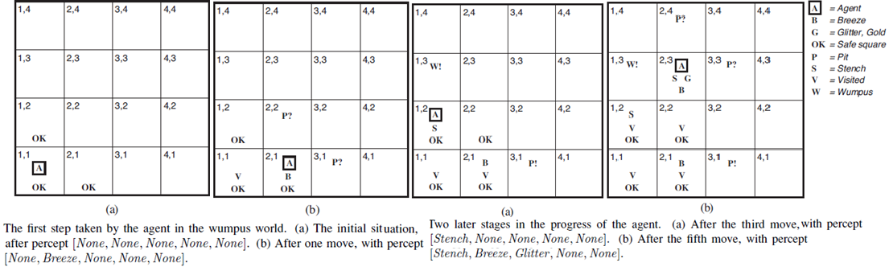
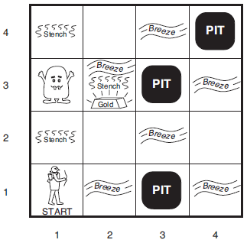
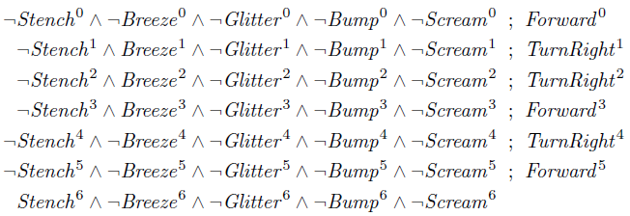
Agents Based On Propositional Logic
ASK(KB, L⁶_{1,2}) = ? ASK(KB,W_{1,3}) = ?
ASK(KB, P_{3,1}) = ? ASK(KB,OK⁶_{2,2}) = ?

Slide 65
A hybrid agent
The ability to deduce various aspects of the state of the world can be combined with condition–action rules and with problem-solving algorithms (A* algo) to produce a hybrid agent for the wumpus world.
The main body of the agent program constructs a plan based on a decreasing priority of goals.
  First, if there is a glitter, the program constructs a plan to grab the gold, follow a route back to the initial location, and climb out of the cave.
  Otherwise, if there is no current plan, the program plans a route to the closest safe square that it has not visited yet, making sure the route goes through only safe squares.
  If there are no safe squares to explore, the next step—if the agent still has an arrow—is to try to make a safe square by shooting at one of the possible wumpus locations.
  If this fails, the program looks for a square to explore that is not provably unsafe—that is, a square for which ASK(KB,￢OKtx,y) returns false.
  If there is no such square, then the mission is impossible and the agent retreats to [1, 1] and climbs out of the cave.

Slide 66
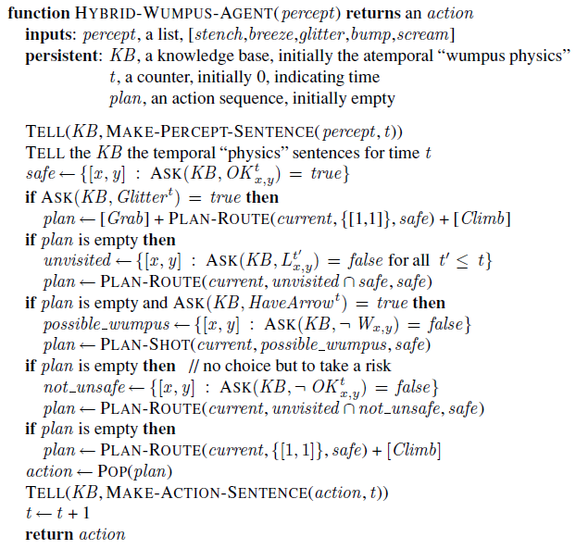
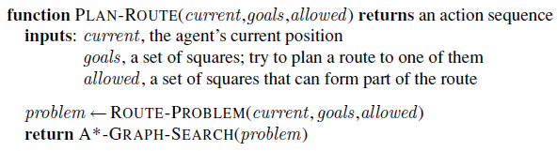
A Hybrid Agent Program

