Slide 1
Introduction to Computer Programming
Dr. Amitesh Singh Rajput
Department of Computer Science & Information Systems

Slide 2
Module Overview
General course information
Objectives of the Course
Computers and Computing
Introduction to Programming
The C language
Program and Process Execution

Slide 3
General Course Information

Slide 4
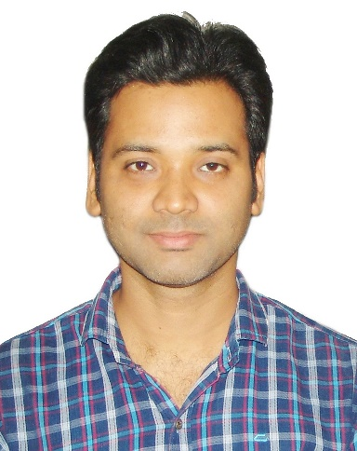
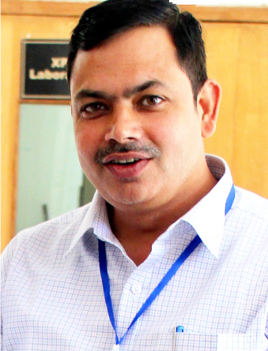
CS F111 - Team
Instructors
Dr. Amitesh Singh Rajput, IC
Prof. Kamlesh Tiwari
Dr. Pratik Narang
Dr. Vinti Agarwal
TAs
Vikas Kumawat, Trishna Paul, Sunil Yadav, Pasunti Prasanjith, Anish Khan,
Mohit, Laxmi Divya Chibbar, Swetha Valavarasu

Slide 5
Evaluation Components
Component | Duration | Weightage (%) | Date | Nature of component (Close Book/ Open Book)
Mid-Semester Test | 90 min. | 25 | 16/03 | Closed book
Comprehensive Examination | 3 hours | 35 | 20/05 | Open/ Closed book
Quiz | 30-40 min. | 10 | TBA | Closed book
Programming Test | 1-2 hours | 20 | TBA | Open book
Laboratory Sessions | 2 hours each | 10 | Weekly | --

Slide 6
Text Book and Reference Books
Text Book:
Hanly, J.R. and E.B. Koffman. Problem Solving and Program Design in C(7/e). Pearson Education, 2013
Reference Books:
Patt, yale. Introduction to computing systems: from bits & gates to C &beyond (2/e). Mcgraw hill education, 2017.
Forouzan, b.A. And richard F. Gilberg . Computer science A structured programming approach using C (3/e). Cengage learning, 2007
Gottfried, B.S. and Jitender chhabra. Programming with C (schaum's outlines series, 3/e). Mcgraw hill education, 2017.
Kernighan, b.W and dennis ritchie. The C programming language (2/e). Pearson education india, 2015.
Das, s. Unix: concepts and applications (4/e). Mcgraw hill education, 2017.
Das, Sumitabha. Computer fundamentals and C programming. New delhi, india: mcgraw hill education. (2018).

Slide 7
Laboratory Sessions & Course Website
Laboratory Sessions
Weekly 2 hours
Lab sessions on Ubuntu – install OS or VM on your machines [DIY]
Course Website
Nalanda – LMS of BITS Pilani
https://nalanda-aws.bits-pilani.ac.in/

Slide 8
Course Objectives

Slide 9
Course Objectives
Computer and Computing Methodologies
Basic concepts of the C programming language
Problem-solving through programming
Systematic techniques and approaches for constructing programs

Slide 10
Computers and Computing

Slide 11
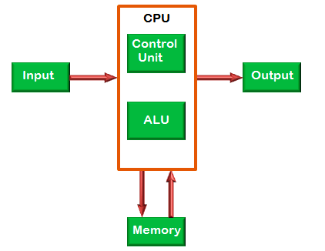
Computer
Computer
A device that takes data as input, does some processing and then returns an output

Slide 12
Types of Memory
Registers (inbuilt on the processor)
Cache (inbuilt on the processor)
Speed
Cost per bit
Size
Primary (RAM, ROM)
Secondary (HDD, FlashMemory)

Slide 13
Introduction to Programming

Slide 14
What is a Program?
Program
Collection of instructions that performs a specific task when executed by a computer
Written using a Programming Language
Programming languages are mechanical and not natural; hence are unambiguous

Slide 15
Levels of Programming Languages
High Level Language
Assembly Language
Ease of understanding
Machine language

Slide 16
Machine Language
Language of the machine
Made up of a series of binary patterns
Can be run directly
Difficult to learn
High Level Language
Assembly Language
Ease of understanding
Machine language

Slide 17
Assembly Language
Uses simple mnemonic abbreviations
Unique to a specific CPU architecture
Requires assembler
High Level Language
Assembly Language
Ease of understanding
Machine language

Slide 18
Assembly Language
An assembly program to add two numbers.
MOV MX, [3000h]
MOV NX, [3002h]
MOV CL, 00h
ADD MX, NX
MOV [3004h], MX
JNC jump
INC CL
jump:
MOV[3006h], CL
HLT

Slide 19
High level Language
English-like
Easier
Requires Compiler
Compiler: Generates object code
High Level Language
Assembly Language
Ease of understanding
Machine language

Slide 20
Example

Slide 21
The C Programming Language

Slide 22
The C language
General Purpose high-level programming language
Language is platform independent
Closely associated with the UNIX operating system
Most versatile as it supports direct access of memory locations through pointers
Compiler based language
C programs are fastest in execution time!

Slide 23
Program and Process Execution

Slide 24
What happens to your program?
You write a program…
Where is your program saved?
What happens to your program when you try to compile and run it?
Before we answer the above questions, let us see what is an operating system…

Slide 25
Operating System (OS)
An OS is a layer of software interposed between the application program and the hardware
OS manages everything of your computer including hardware
OS is responsible for executing your program
A program under execution is known as a process

Slide 26
Basic layout of Computer Hardware
OS Manages these resources
CPU
Disk
Memory (RAM)

Slide 27
What happens to your program?
Now let us answer these questions…
Where is your program saved?
What happens to your program when you try to compile and run it?

Slide 28
1. Where is your program saved?
Your program when saved gets stored on the disk
Program
CPU
DISK
Memory (RAM)

Slide 29
What happens to your program?
Now let us answer these questions…
Where is your program saved?
What happens to your program when you try to compile and run it?

Slide 30
2. What happens to your program when you try to compile and run it?
OS loads the program into RAM
Executes it line by line on CPU
Program
Program
Program
Program is executed on CPU
Program gets loaded into RAM
CPU
DISK
Note: Program under execution is known as a Process
Memory (RAM)

Slide 31
Thank you!
Q & A

