Slide 1
Module 12 – part 2 – Circular and Doubly Linked Lists
Dr. Ashutosh Bhatia and Dr. Asish Bera
Department of Computer Science & Information Systems

Slide 2
Module Overview
Circular Linked Lists
Doubly Linked Lists

Slide 3
Circular Liked Lists and cycles in a Linked List

Slide 4
Circular Linked List
head
10
next
8
next
4
next
20
next
The next of the last node points to the first node
Result:
Traversing the list is an infinite operation as you will never encounter a NULL pointer

Slide 5
More examples
head
10
next
8
next
4
next
head
10
next
8
next
4
next
20
next

Slide 6
Detecting cycles in linked list

Slide 7
Cycle in a linked list
Solution 1:
Traverse the list. While traversing, store the addresses of all the visited nodes in an array/table.
When we traverse from node1 to node2, check if the address of node2 already exists in the table. If YES, a cycle is detected. If not, add address of node 2 to the table and go forward.
If you encounter a NULL in the traversal, then the list doesn’t have a cycle.

Slide 8
Cycle in a linked list
Solution 2: This solution requires modifications to the basic linked list data structure.
Have a visited flag with each node
Traverse the linked list and keep marking visited nodes
If you see a visited node again then there is a cycle
If you encounter a NULL in the traversal, then the list doesn’t have a cycle.

Slide 9
Cycle in a linked list
Solution 3: This is the fastest method
Traverse linked list using two pointers (slow_p & fast_p)
Move (slow_p) by one node and fast_p by two.
If these pointers meet at the same node then there is a cycle.
If pointers do not meet then linked list doesn’t have a cycle. OR if either pointer encounters a NULL in the traversal, then the list doesn’t have a cycle.

Slide 10
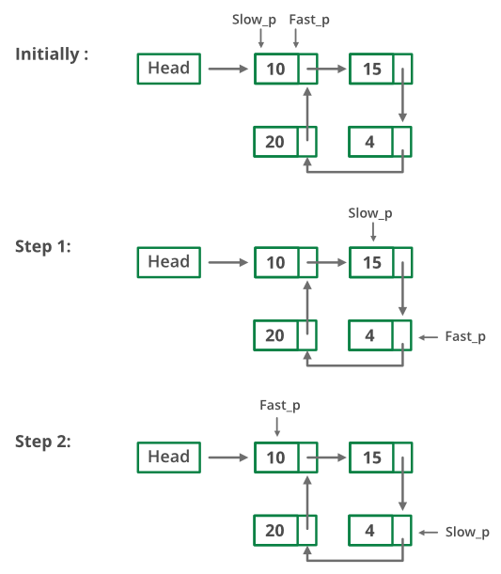
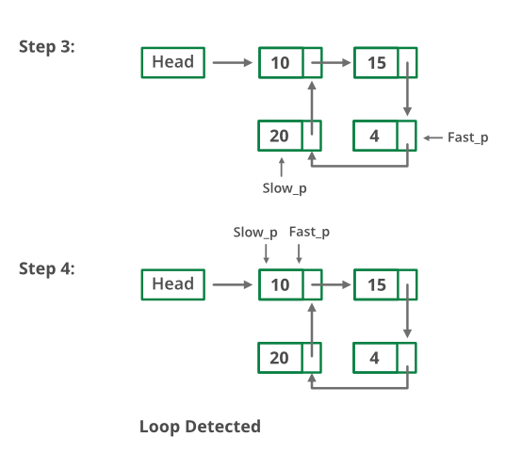
Solution 3 illustrated

Slide 11
Doubly Liked Lists

Slide 12
Doubly Linked Lists
head
prev
ele
next
prev
ele
next
prev
ele
next
NULL
NULL
Each node now stores:
value of the element stored at that node: ele
address of the next node: next
address of the previous node: prev
The head node contains the address of the first node
The next of the last node points to NULL, meaning end of the list
The prev of the first node points to NULL, meaning beginning of the list
Supports two-way traversal of linked lists

Slide 13
Doubly Liked Lists – Implementation

Slide 14
Structure definitions for doubly linked lists
head
prev
ele
next
prev
ele
next
prev
ele
next
NULL
1st node
2nd node
3rd node
NULL
Consider that our doubly linked list stores integer elements.
struct dllnode{
int ele;
struct dllnode * next;
struct dllnode * prev;
};
struct doubly_linked_list{
int count;
struct dllnode * head;
};

Slide 15
Creating a new doubly linked list
typedef struct dllnode * DLLNODE;
struct dllnode{
int ele;
DLLNODE next;
DLLNODE prev;
};
typdef struct doubly_linked_list * DLIST;
struct doubly_linked_list{
int count;
DLLNODE head;
};
DLIST createNewList(){
DLIST myList;
myList = (DLIST) malloc(sizeof(struct doubly_linked_list));
// myList = (DLIST) malloc(sizeof(*myList));
myList->count=0;
myList->head=NULL;
return myList;
}
myList
count=0
head=NULL

Slide 16
Creating a new node
typedef struct dllnode * DLLNODE;
struct dllnode{
int ele;
DLLNODE next;
DLLNODE prev;
};
typdef struct doubly_linked_list * DLIST;
struct doubly_linked_list{
int count;
DLLNODE head;
};
DLLNODE createNewNode(int value){
DLLNODE myNode;
myNode = (DLLNODE) malloc(sizeof(struct dllnode));
// myList = (DLLNODE) malloc(sizeof(*myNode));
myNode->ele=value;
myNode->next=NULL;
myNode->prev=NULL;
return myNode;
}
prev=NULL
myNode
ele=value
next=NULL

Slide 17
Inserting a node into the list
void insertNodeIntoList(DLLNODE n1, DLIST l1){
// case when list is empty
if(l1->count == 0) {
l1->head = n1;
n1->next = NULL;
n1->prev = NULL;
l1->count++;
}
// case when list is non empty
else {
... ...
}
}
prev
NULL
count=0
10
head
NULL
next
NULL
count=1
prev
NULL
head
10
next
NULL

Slide 18
Inserting a node into the list (contd.)
void insertNodeIntoList(DLLNODE n1, DLIST l1){
// case when list is empty
if(l1->count == 0) {
... ...
}
// case when list is non empty
else {
n1->next = l1->head;
n1->prev = NULL;
n1->next->prev = n1;
l1->head = n1;
l1->count++;
}
}
NULL
prev
NULL
n1
8
NULL
next
prev
prev
prev
4
count=3
10
30
25
l1
head
next
next
next
NULL

Slide 19
Removing a node from the beginning of the list
void removeFirstNode(LIST l1)
{
if (l1->count == 0)
{
printf("List is empty. Nothing to remove\n");
}
else
{
NODE temp = l1->head;
l1->head = temp->next;
l1->head->prev = NULL;
free(temp);
l1->count--;
}
return;
}
Do we have to bother about removing this link?
NULL
prev
NULL
8
prev
prev
prev
next
count=4
10
30
25
3
l1
head
next
next
next
NULL

Slide 20
Other functions (exercise)
Exercise: Implement the following functions for a linked list:
insertNodeAtEnd(DLIST mylist, DLLNODE n1) : inserts n1 at the end of mylist
insertAfter(DLIST mylist, DLLNODE n1, int v): inserts n1 into mylist after a node containing a value v
removeLastNode(DLIST mylist) : removes the last node from mylist
search(int data, DLIST mylist): returns the node that contains its ele=data
printList_forward(DLIST mylist): prints the elements present in the entire list in a sequential fashion in forward direction starting from the first element
printList_backward(DLIST mylist): prints the elements present in the entire list in a sequential fashion in backward direction starting from the last element
removeElement(int data, DLIST mylist): removes the node that has its ele=data
isEmpty(DLIST mylist): checks if the list is empty or not
Modify the insert/delete functions to first check whether the list is empty using isEmpty() function.

Slide 21
Thank you
Q & A

